Slide 1


Scan cycle and data processing

Slide 2
Field | Automation and robotics
Chapter | Scan cycle and data processing
Subtitle | General

Slide 3
Programmable logic controller ( PLC)
The operating system of the PLC controller is designed precisely for a specific type of application. The PLC maps the signals from the sensors into the signals that are transmitted to the actuators. The PLC is expected to:
periodically read (enter) signals from sensors
perform a certain number of arithmetic-logical operations
transmit the results to the executive authorities
maintain communication (exchange data)

Slide 4
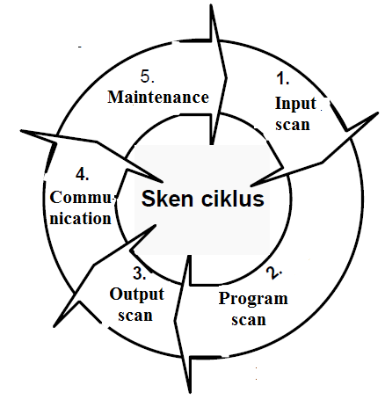
Programmable logic controller ( PLC)
The PLC of the controller is designed so that, during the operation of the system, it automatically ensures the cyclical repetition of the mentioned activities (Scan cycle) as illustrated in the figure

Slide 5
Scan cycle of PLC devices
The scan cycle begins with an input scan in which the PLC reads the content of the input lines (input module registers). The read data is transferred to a specific memory area - the input image.

Slide 6
Program SCAN (PLC)
Then the program scan is activated, within which the processor executes program commands that define the corresponding arithmetic-logic functions. Data (operands) used in program commands are taken from memory, from the area designated as the input image (if the operands are input data) or from the area where internal variables are placed. The processing results are placed in a special memory area - the output image.

Slide 7
Program SCAN (PLC)
At the end of the program scan cycle, the operating system of the PLC device activates the output scan in which the data from the output image is transferred to the output lines (output module registers). The fourth part of the scan cycle - communication - is intended for the implementation of data exchange with devices connected to the PLC

Slide 8
Program SCAN ( PLC)
The next step is that the system brings the PLC into the maintenance phase, in which the internal clocks are updated and the register performs memory management, as well as a number of other jobs related to system maintenance, about which the user does not need to be informed. Depending on the type of processor, the input and output scan cycles are executed in milliseconds (from 0.25 ms to 2.56 ms). The duration of the program scan certainly depends on the size of the program.

Slide 9
Program SCAN (PLC)
Generally speaking, PLC users are expected to, depending on the applications he intends to :
Perform input selection,
Output communication and special modules,
Select the structure of the PLC and,
Form a data processing program.
All other activities will be performed and monitored by the PLC operating system.

Slide 10
Literature :
Script prof. Dr Milutin Petronijević “Predavanja iz specijalnih električnih mašina 2014-2015”, Elektronski fakultet u Nišu,
Script prof. dr Zoran Janković for subject Programabilno logički kontroleri

Slide 11
THANKS!
Any questions?

