Slide 1


Basic structure and construction of PLC devices

Slide 2
Field | Automation and robotics
Chapter | Basic structure and construction of PLC devices
Subtitle | General

Slide 3
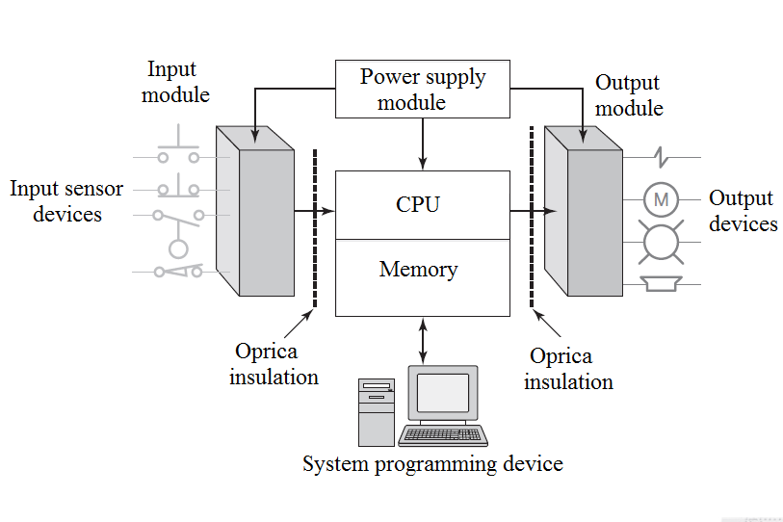
Programmable logic controller ( PLC)
A typical PLC system consists of several parts, as shown in the figure.
central processing unit
input / output components
power supply and
system programming device.

Slide 4
Programmable logic controller ( PLC)
The term architecture may refer to PLC hardware, PLC software, or a combination thereof. In addition, although the main concepts are the same in all programming methods, there may be slight differences in some models in addressing, memory allocation, or data loading and processing. For these reasons, PLC programs are not interchangeable between devices from different PLC manufacturers.
Open architecture
An open architecture system easily connects to third-party devices and programs. Open architectures use ready-made components that comply with proven standards.
Closed architecture
A closed architecture system is one whose design is determined by the system manufacturer, which makes it difficult to connect to devices from other manufacturers. Since many PLC systems are actually closed architectures, you must make sure that certain generic hardware or software you may be using is compatible with a particular PLC device.

Slide 5
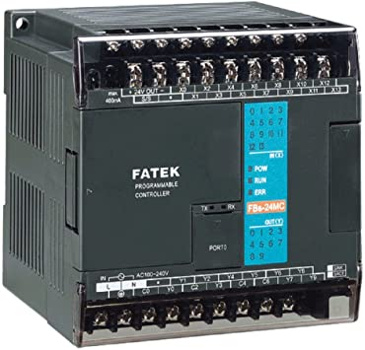
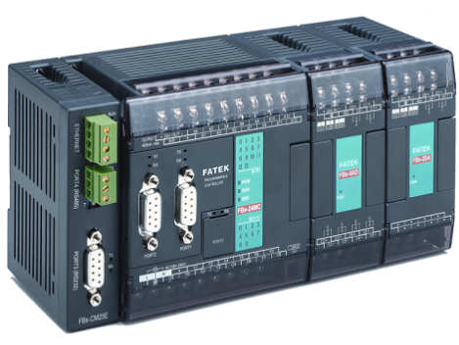
Input-output ports of the PLC
There are two ways in which inputs / outputs can join a PLC:
Fixed PLC
Fixed I / O are typical for small controllers that are manufactured in enclosures to which no additional units can be connected.
Modular PLC
Modular I / O is divided into sections where separate modules can be inserted. This feature significantly increases the capabilities and flexibility of the unit.

Slide 6
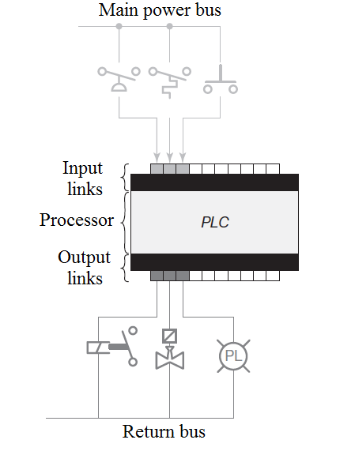
Fixed inputs - outputs PLC
The processor and I / O components are housed in a common housing with a fixed number of terminals for connecting external input and output devices. The main advantage of this type of housing is the low price.
The number of I / O terminals available can be increased by purchasing additional units with a fixed number of I / O terminals. One of the disadvantages of fixed I / O components is the lack of flexibility because you are limited in terms of the amount and type of connected devices to what you get in the PLC housing. In addition, in some models, if any part of the unit breaks down, you must replace the entire unit.

Slide 7
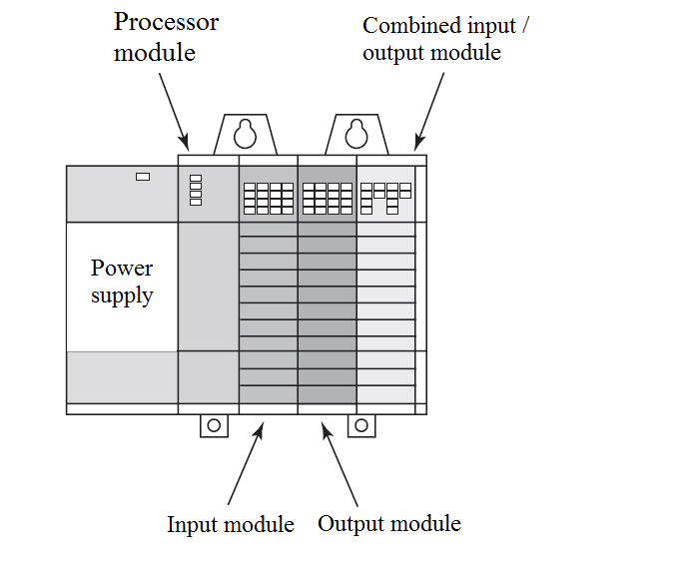
Modular inputs - outputs PLC
With modular, you can choose between several modules from one manufacturer and combine them however you like. The basic modular controller consists of:
river (chassis),
power supply,
processor module (CPU),
input-output components (I / O modules)
and operator interface

Slide 8
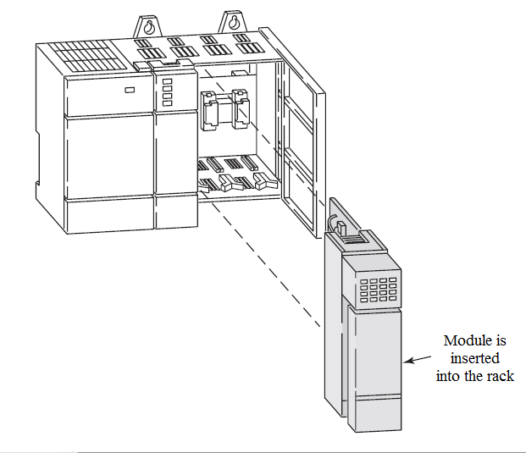
Modular inputs - outputs PLC
The operator interface allows programming and monitoring of program operation. The modules are designed to fit into a common rack. When the module plugs into the rack, it automatically closes through electrical contacts, called backplanes, located on the back of the rack.
The processor built into the PLC is also connected to the background bus and can communicate with all modules in the river.

Slide 9
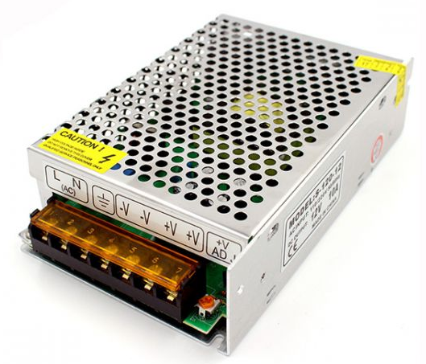
PLC power supply
Provides direct current for all modules plugged into. In systems with a large number of PLC units, this power supply usually does not supply energy to external devices. In more extensive systems, external devices have their own AC or DC power supply. In some small PLC systems, the power supply of PLC units can also be used to drive external devices in the system.

Slide 10
Literature :
https://www.automatika.rs/baza-znanja/uvod-u-leder-programiranje.html
Script prof. dr Srbijanka Turajlić for subject Automatic control systems
Script prof. dr Zoran Janković for subject Programabilno logički kontroleri

Slide 11
THANKS!
Any questions?

