Slide 1


Advantages of using PLC devices

Slide 2
Field | Automation and robotics
Chapter | Advantages of using PLC devices
Subtitle | The role and importance of PLC-devices

Slide 3
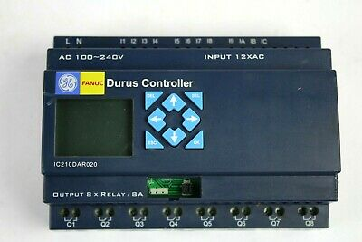
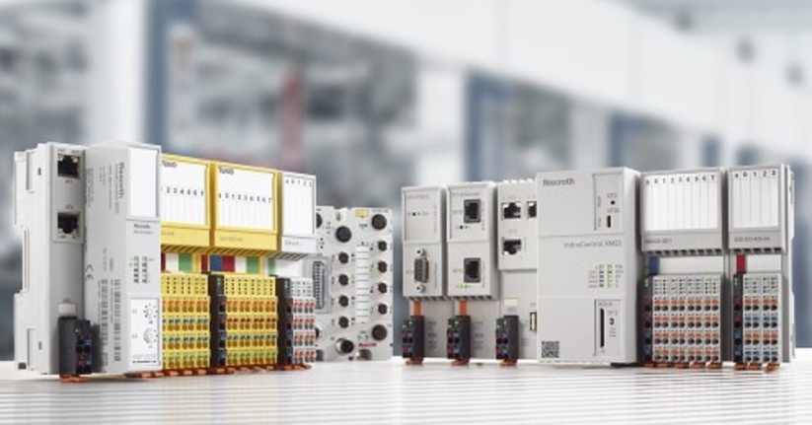
Programmable logic controller ( PLC)
Introduction
Programmable logic controllers (PLCs), such as one in figure , are widely used today in industrial process control technologies. A programmable logic controller is a computer designed for use in industrial environments, which can be programmed to perform control functions. The programmable controller has eliminated most of the wired connections required in relay control circuits.

Slide 4
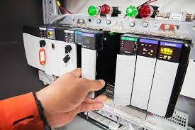
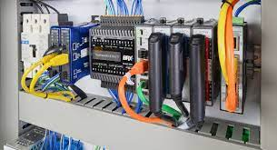
Other advantages of PLC are:
easy programming and installation,
high response speed,
network compatibility
easy debugging and testing,
high reliability

Slide 5
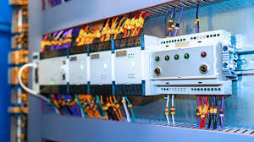

Programmable logic controller ( PLC)
The programmable logic controller is designed to accept multiple different input and output layouts and withstand a wide range of operating temperatures.
It is insensitive to electrical noise and is resistant to vibration and shock. Programs that manage the production of machinery and equipment are usually stored in memory that is permanent or self-powered. A PLC is an example of a real-time system because the state of the PLC-controlled system outputs depends on the state of the system's inputs.

Slide 6
Programmable logic controller ( PLC)
Therefore, a programmable logic controller is essentially a digital computer designed to control a specific machine or plant. Unlike a personal computer, a PLC is designed to work in an industrial environment, equipped with special input and output interfaces, and programmed using a special process control language. The common abbreviation PC used for this type of device in the industry can be confusing because it is also an abbreviation for "personal computer" (PC). For this reason, most manufacturers call their programmable logic controllers abbreviated PLC.

Slide 7
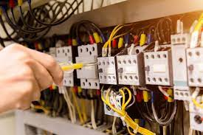

PLC – Relay technology
Considering the fact that the PLC structure is based on the same principles as those applied in computer architecture, the PLC can perform not only the same tasks as relay technology, but is also suitable for other applications - for example, timekeeping, counting, computing, comparison and processing of analog signals.

Slide 8
Greater reliability
After you write and test the program, you can easily install it on other PLC systems. Since the entire logic is stored in the PLC memory, there is no possibility of introducing a logic error due to incorrect wiring (Figure 1-3). The program replaces most of the external cable connections that would otherwise be required to control the process. Direct cable connections are still needed to connect to external devices, but their number is much smaller. The reliability of the PLC is significantly contributed by the components made in the technology of integrated circuits.

Slide 9
Greater flexibility
It is easier to write and modify a program installed in a PLC than to change the wiring of an electrical circuit. The relation between the inputs and outputs of the program controller is determined by the program written by the user, not the way these inputs and outputs are interconnected. Original equipment manufacturers (OEMs) can forward changes to users by sending them new versions of the program. End users can change programs on the spot themselves, and if desired, the program can be protected by certain hardware measures, such as locking cabinets with equipment, or using a software password.

Slide 10
Lower costs
The original purpose of the PLC was to replace relay control logic, but the savings have become so significant that relay control is increasingly considered obsolete, except when operating with high currents and high voltages. If more than half a dozen control relays are needed for a particular application, it would probably be cheaper to use a PLC.

Slide 11
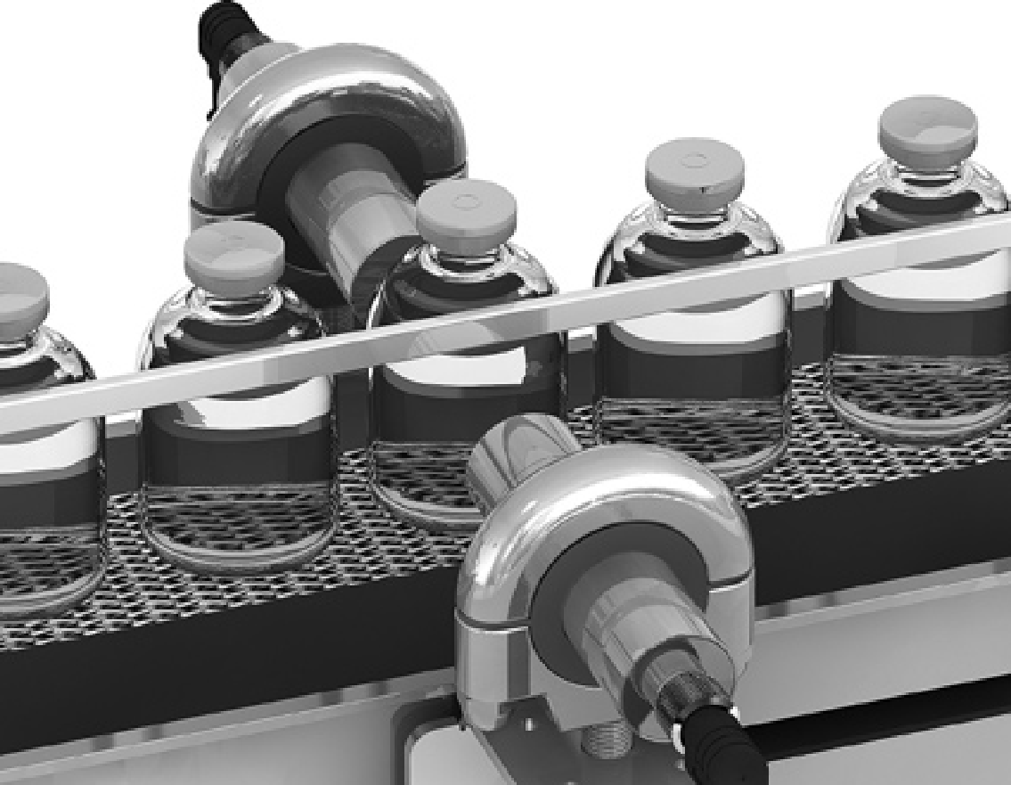
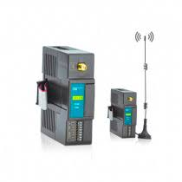
Ability to communicate
The PLC can communicate with other controllers or other computer equipment to perform functions such as system monitoring, data acquisition, device and process parameter monitoring, and program installation.

Slide 12
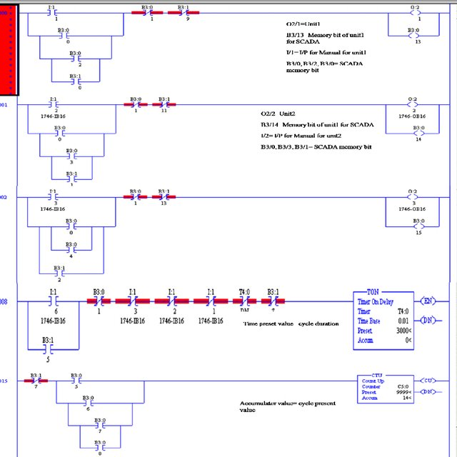
Easier debugging
The PLC has built-in diagnostic features that allow the user to easily monitor system operation and correct software and hardware problems. To detect and solve problems, users can see the driver on the monitor and watch it work in real time.

Slide 13
Literature :
https://www.automatika.rs/baza-znanja/uvod-u-leder-programiranje.html
Script prof. dr Srbijanka Turajlić for subject Automatic control systems

