Slide 1


WHAT ARE THE DIFFERENT TYPES OF AUTOMATION?

Slide 2
Field | Automation and robotics
Chapter | WHAT ARE THE DIFFERENT TYPES OF AUTOMATION?
Subtitle | What is automation Fields of automation

Slide 3
What are the different types of automation?
Fixed automation is a system in which the sequence of processing (or assembly) operations is fixed by the configuration of the equipment. Each of the operations is simple, including the usual linear or rotational movement or an uncomplicated combination of the two. For example, the power of a rotating spindle.

Slide 4
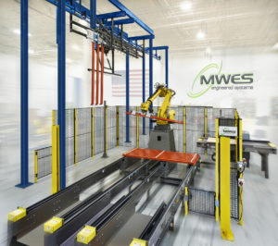
Fixed automation
In fixed automation, the sequences and types of operations allowed by the configuration of the equipment are finite and preset. Wiring, cams, gears and other hardware deliver the programmed instructions that fixed automation machines follow in the production process. These systems tend to manufacture the same product style, and they are designed in a way that makes changing product styles difficult.

Slide 5
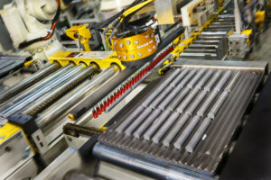
Fixed automation
Fixed automation system examples include:
Automated assembly machines
Chemical manufacturing processes
Material handling conveyor systems
Machining transfer lines
Paint & coating automation processes
Web Handling and converting systems

Slide 6
What are the different types of automation?
In programmable automation, production equipment is designed with the ability to change the order of operations in order to adapt to different product configurations. The order of operations is controlled by a program, which is a set of instructions coded so that the system can read and interpret them.

Slide 7
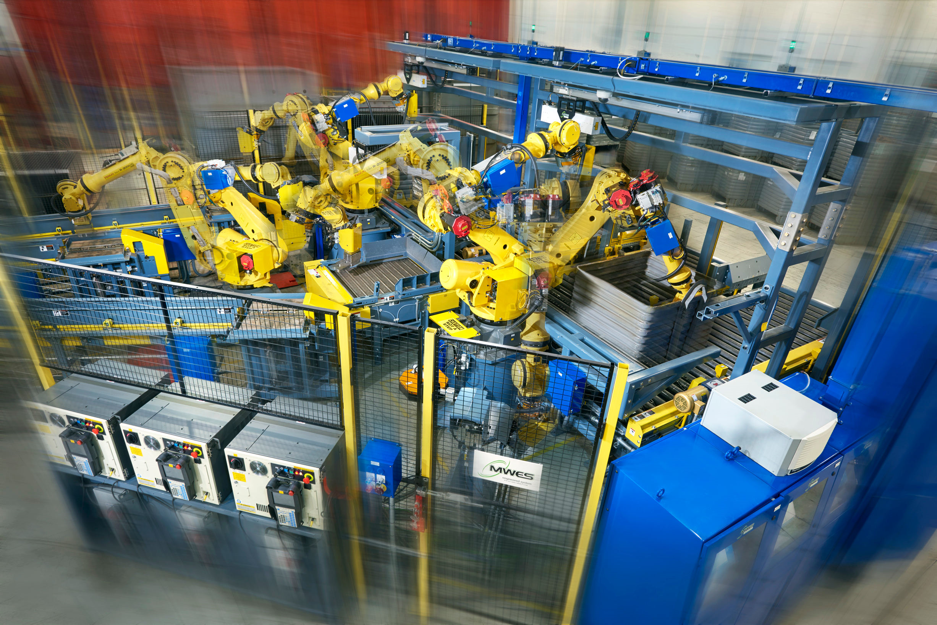
Programmable automation
Whenever a new product batch is required, the programmable automation equipment can be changed and reprogrammed to handle the new and different product types. The automated production line process cannot continue while the reprogramming and changeover processes are occurring. After these changes, the production of a new type of batch runs.

Slide 8
Programmable automation
As these factory automation processes are not changed often, programmable automation systems are usually less expensive than fixed system automation to operate over time. However, production rates are lower for programmable automation than for fixed automation due to the equipment’s changeover-optimized design, as opposed to being designed to work best for product specialization. Programmable automation systems are best used in settings with medium-to-high production level requirements and low product variety.

Slide 9
What are the different types of automation?
Flexible automation systems are highly-adaptable systems with computer input and controls. Commands are created and entered by human operators using computer code or through other Human Machine Interfaces (HMIs). These computer instructions are high-level, starting low-level changes automatically and identifying various automation processes and their system locations.

Slide 10
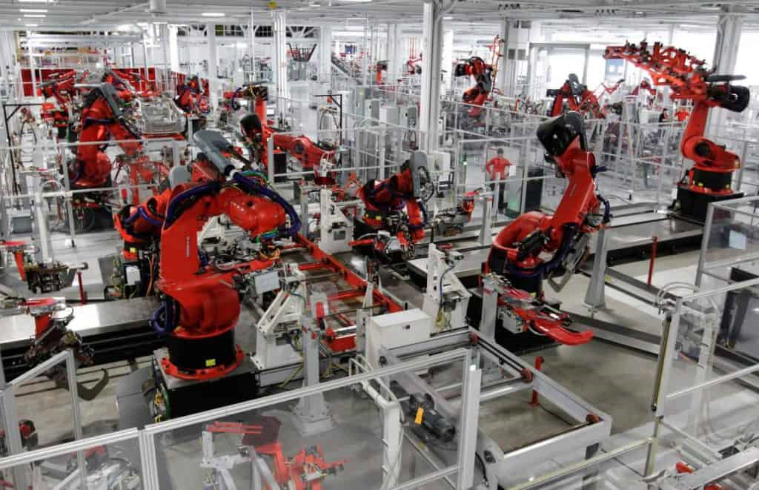
Flexible automation
In flexible automation systems, multiple machine tools can be connected to a sophisticated material-handling system typically through robotic automation. Each aspect of the production and material-handling system is controlled from a central computer system.

Slide 11
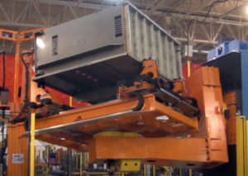
Flexible automation
In the flexible automation system process, computers controlled by human operators issue instructions to machine tools. These computer-generated instructions begin processes of loading and unloading the machine tools that are necessary for performing the processes necessary to manufacture the desired parts. After the production automation system finishes its final manufacturing stage, the resulting products are moved to the next machine in the sequence automatically.

Slide 12
Flexible automation
Flexible automation systems are capable of processing multiple product types at the same time. During any production run, each of the system’s machines could potentially be processing a different product or part type. As system requirements and demands change, the flexible automation system has the adaptability to handle them. This factory automation system can manage changes to production schedules, demand patterns and product mix changes. So long as a newly introduced product style fits within the kinds of products that a flexible automation system is configured to process, new part versions could easily be introduced into the production system.

Slide 13
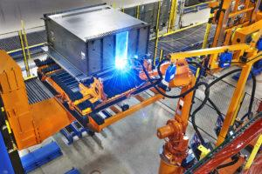
Flexible automation
Flexible automation systems are the ideal system for batch processes and shops that have low-to-medium production level needs and high product-variety needs. Systems that will likely have changes in demand and have production needs less than high-volume will be a great fit for flexible automation systems.

Slide 14
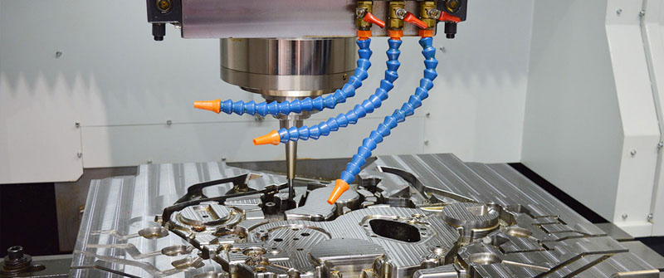
Flexible automation
Flexible automation systems typically have the following components:
Part processing machines: Computer-numerical-control (CNC) machine tools are used to carry out some portion of the machining processes. Inspection stations and other automated workstations may be used in conjunction with these processing machines.

Slide 15
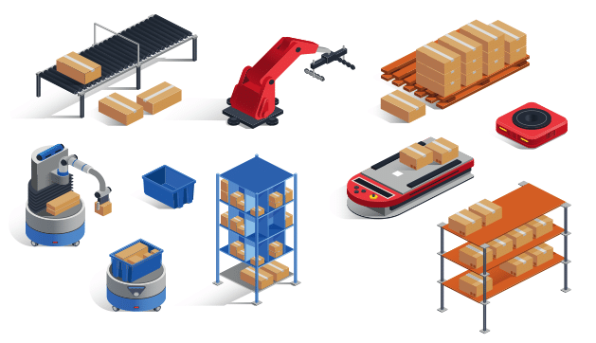
Flexible automation
Material-handling system: Conveyor systems or other systems that can move parts in production to any machine in the flexible automation system. Robotic automation is typically used to load and unload production machines from these material handling systems.

Slide 16
Flexible automation
Central computer control system: Communicates part routing information and timing to machines in the material-handling system as well as coordinating each part processing machines’ operations

Slide 17
Flexible automation
Human labor: The flexible style of automation system has an inherently high level of automation in its processes. However, people are still necessary for several important steps in the system. They are necessary for the overall management of the system, the repair and the maintenance of the production equipment, the tool change procedures and sometimes for the loading and unloading of parts.

Slide 18
THANKS!
Any questions?

