Slide 1


Analog input modules

Slide 2
Field | Automation and robotics
Chapter | Transformation of analog input-output signals
Subtitle | Analog input modules

Slide 3
PLC Analog Input
Continuous values, like temperatures and pressures, are analog values. We frequently think about them in digital terms, but at some point, we must translate them from the continuous world into a digital world. This is when a PLC analog input comes into play. Both milliampere current and low voltage signals are analog inputs to PLCs.
Discrete devices are inputs and outputs that have only two states: on and off. In comparison, analog devices represent physical quantities that can have an infinite number of values. Typical analog inputs and outputs vary from 0 to 20 milliamps, 4 to 20 milliamps, or 0 to 10 volts.

Slide 4
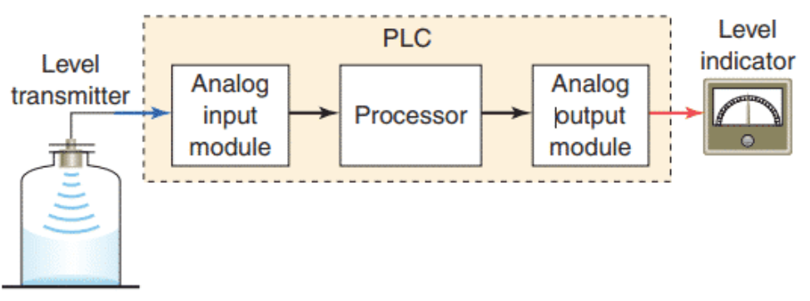
PLC Analog Input
The figure illustrates how PLC analog input and output modules are used in measuring and displaying the level of fluid in a tank. The analog input interface module contains the circuitry necessary to accept an analog voltage or current signal from the level transmitter field device. This input is converted from an analog to a digital value for use by the processor. The circuitry of the analog output module accepts the digital value from the processor and converts it back to an analog signal that drives the field tank level meter.

Slide 5
Voltage and Current
There are two basic types of analog input signals: Voltage and Current
Wiring a Current analog input can be divided into three types:
2-wire Analog Input
3-wire Analog Input
4-wire Analog Input
The manufacturer of the field device specifies how that specific device is wired. It is not usually a choice you get to make (unless you find a different manufacturer with the same type of field device that wires differently)

Slide 6
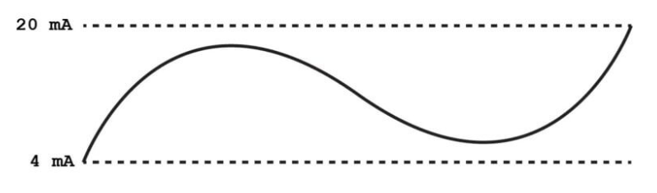
4-20mA
In the process automation industry, a point-to-point or multi-drop circuit is typically used to send signals from field instruments and sensors to a controller. It sends a 4 to 20 mA analog signal ranging from 0 to 100% of a process variable. In addition to powering the sensor transmitter on the same wire pair as a current loop signal, 4-20 mA also offers more immunity to interference than a voltage-based signal. A 0-20 mA signal is also offered, but has less advantage than a 4-20mA signal because if the signal goes dead (0 mA), a 4-20 mA signal would read very negative and would tell the PLC something is wrong with the signal.

Slide 7
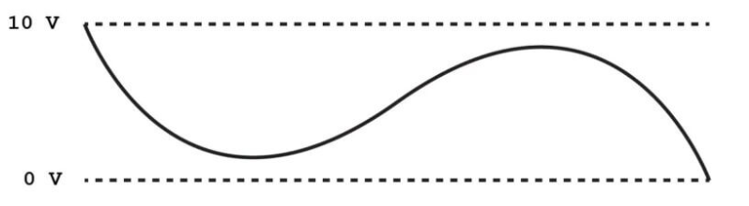
0-10 VDC
0-10 VDC is an analog control signal used to control damper and valve actuators, VFD control, temperature, humidity, pressure sensors, and temperature reset. It is a commonly used control signal in the HVAC sector that is simple, trouble-free, and often used worldwide. It is measured using a voltmeter capable of checking DC voltage. Firstly, we must identify the wires’ signal (+) and the negative/common (-). Then set your meter to DC volts. Later, place the positive lead from the meter to the signal output terminal. Notice the output voltage.

Slide 8
Unipolar and bipolar
Analog voltage input modules are available in two types: unipolar and bipolar
Unipolar modules can accept an input signal that varies in the positive direction only. For example, if the field device outputs 0 V to +10 V, then the unipolar modules would be used.
Bipolar signals swing between a maximum negative value and a maximum positive value. For example, if the field device outputs -10 V to +10 V a bipolar module would be used.
The resolution of an analog input channel refers to the smallest change in input signal value that can be sensed and is based on the number of bits used in the digital representation.
Analog input modules must produce a range of digital values between a maximum and minimum value to represent the analog signal over its entire span.

Slide 9
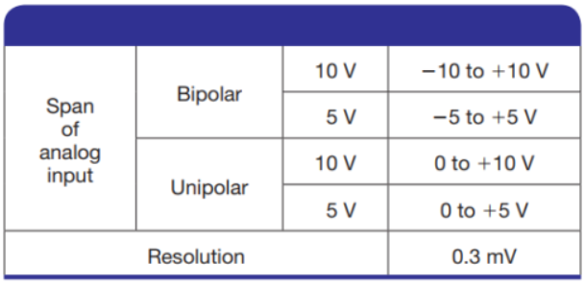
Unipolar and bipolar
Typical specifications are as follows:

Slide 10
THANKS!
Any questions?

