Slide 1


Sensors and drive in robotics

Slide 2
Field | Automation and robotics
Chapter | Sensors and drive in robotics
Subtitle | General

Slide 3
BASICS – MEASUREMENT DEVICES
Measurement devices perform a complete measuring function, from initial detection to final indication. The important aspects of measurement system are:
Sensor – Primary sensing element
Transducer – changes one form of energy to another form energy
Transmitter – Contains the transducer and produces an amplified, standardized energy signal.

Slide 4
INTRODUCTION – SENSORS
A device which provides a usable output in response to a specified measurand.
Sensor is a device that detects and responds to some type of input from the physical environment
Input could be light, heat, motion, moisture, force, pressure, displacement, etc.
It produces a proportional output signal (electrical, mechanical, magnetic, etc.).
Human beings are equipped with 5 different types of sensors.
Eyes detect light energy, ears detect acoustic energy, a tongue and a nose detect certain chemicals, and skin detects pressures and temperatures. The eyes, ears, tongue, nose, and skin receive these signals then send messages to the brain which outputs a response

Slide 5
CHARACTERISTICS
Range
It is the difference between the maximum and minimum value of the sensed parameter. Temperature range of a thermocouple is 25-225°C
Resolution
The smallest change the sensor can differentiate. It is also frequently known as the least count of the sensor. Resolution of an digital sensor is easily determined.
Error
Error is the difference between the result of the measurement and the true value of the quantity being measured. The classification of errors are as follows:
*Bias errors (systematic errors) *Precision (Random errors)
Bias errors are present in all measurement made with a given sensor and cannot be detected (or) removed by statically means
Sensitivity
It is the ratio of change in output to a unit change of the input. The sensitivity of digital sensors is closely related to the resolution. The sensitivity of an analog sensor is the slope of the output vs input line, or sensor exhibiting truly linear behaviour has a constant sensitivity over the entire input range.

Slide 6
STANDARD SIGNAL TYPES
Most modern equipment works on the following standard signal ranges
Electric – 4 to 20 mA
Pneumatic – 0.2 to 1.0 bar (or) 3 to 15 psi
Digital standards
The advantage of having a standard range is that all equipment is sold readily calibrated. This means that minimum signal (temperature, speed, force, pressure and so on)is represented by 4 mA or 0.2 bar and the maximum signal is represented by 20 mA or 1.0 bar

Slide 7
PRINCIPLE OF RESISTIVE SENSORS
A resistive sensor is a electromechanical device that converts a mechanical change such as displacement into an electrical signal that can be monitored.
Resistance = (Resistivity * Length)/Area;
R = ρ L / A
The resistance of a material depends on four factors:
    Composition
Temperature
Length
Cross Sectional Area

Slide 8
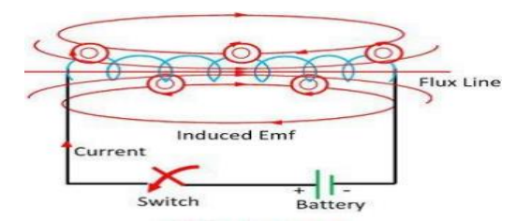
INDUCTIVE TRANSDUCER
Self inductance is the production of emf in a circuit when a magnetic flux linked with the circuit changes as a result of change of current.
It works on principle of self inductance
Only a single coil is employed.
Self induction transducers are usually variable reluctance devices
Application: this can be used as displacement sensor, proximity sensor etc

Slide 9
CAPACITIVE TRANSDUCERS
The principle of operation of capacitive transducers are based on the following expression, The capacitance C of a parallel plate capacitor is given by,
C = εr εo A / d
Where,
εr is the relative permittivity of the dielectric between the plates,
εo permittivity of free space,
A area of overlap between two plates and d the plate separation.
Capacitive sensor is of non-contact type sensor and is primarily used to measure the linear displacements from few milli meters to hundreds of milli meters.

Slide 10
Literature :
Script prof. Dr Milutin Petronijević “Predavanja iz specijalnih električnih mašina 2014-2015”, Elektronski fakultet u Nišu,
Book Technician's Guide to Programmable Controllers by Terry Borden

Slide 11
THANKS!
Any questions?

