Slide 1


Field | Automation and robotics
Chapter | Significance and role of industrial robots
Subtitle | Features and characteristics of industrial robots Significance and role of industrial robots

Slide 2
Significance and role of industrial robots

Slide 3
Industrial robots
Industrial robots are machines designed and programmed to automate various tasks in industrial settings. They are commonly used in manufacturing, assembly lines, and other industrial processes to improve efficiency, productivity, and precision. Industrial robots are typically characterized by their ability to perform repetitive tasks with speed, accuracy, and consistency, often replacing or assisting human workers in hazardous or physically demanding environments.

Slide 4
Here are some key features and characteristics of industrial robots:

Slide 5
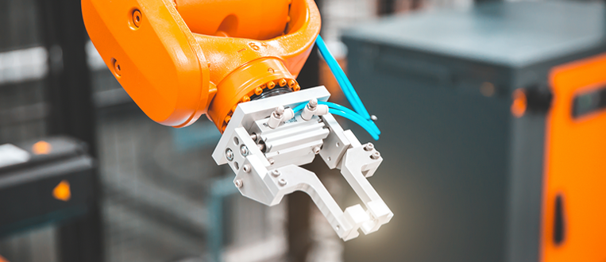
Manipulation
Industrial robots are equipped with mechanical arms or manipulators that can perform a wide range of tasks, including lifting, carrying, and positioning objects with precision.

Slide 6
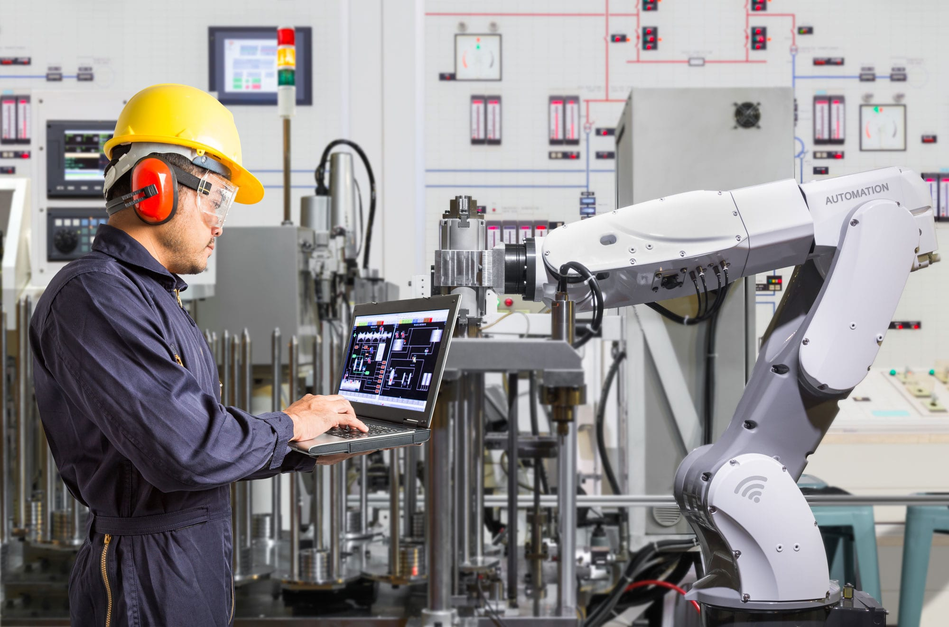
Programming
Robots can be programmed to perform specific tasks by using programming languages or intuitive interfaces. Programming may involve specifying movement patterns, object recognition, and interaction with other machinery.

Slide 7

Programming

Slide 8
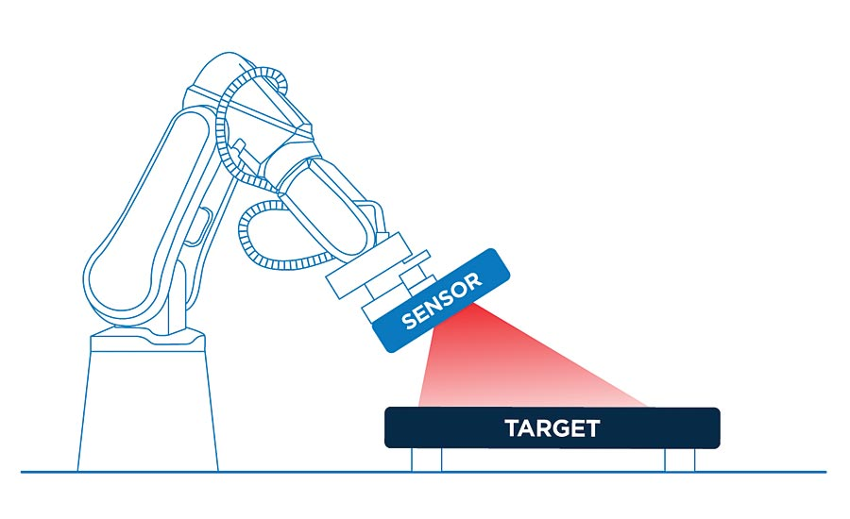
Sensors
Industrial robots often incorporate various sensors such as vision systems, force/torque sensors, proximity sensors, and laser scanners. These sensors enable the robot to perceive its environment, detect objects, and make appropriate decisions.

Slide 9
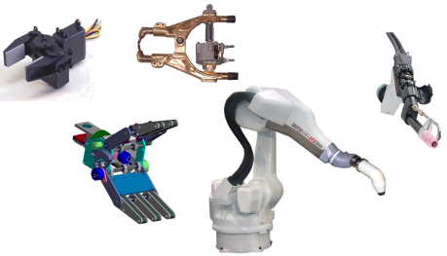
End Effectors
The end effector, or tooling, is the attachment at the end of the robot's arm that interacts with the workpiece or the environment. Examples of end effectors include grippers, welding torches, drills, and painting tools.

Slide 10
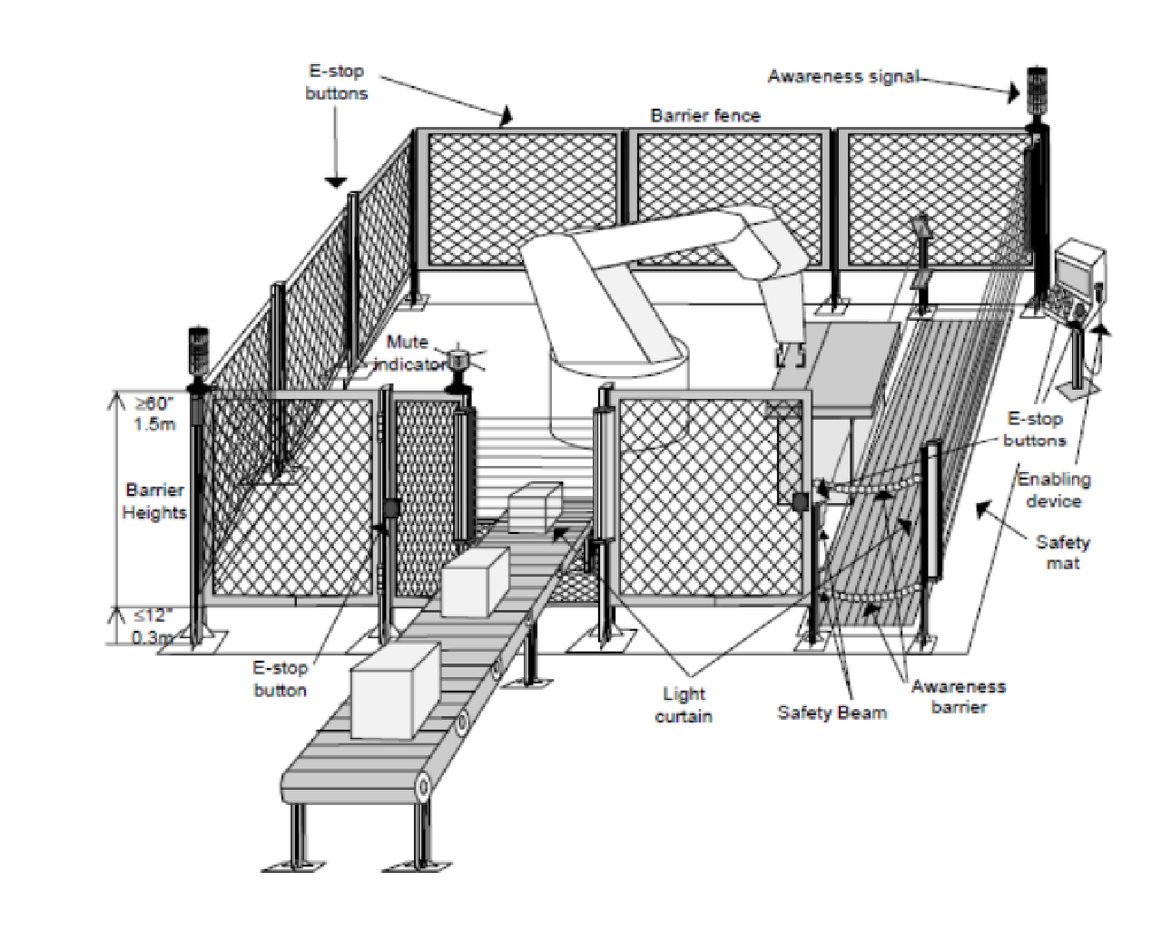
Safety Measures
Industrial robots are designed with safety features to protect human operators and prevent accidents. These may include protective barriers, emergency stop buttons, and safety sensors that can detect human presence and stop the robot's motion.

Slide 11
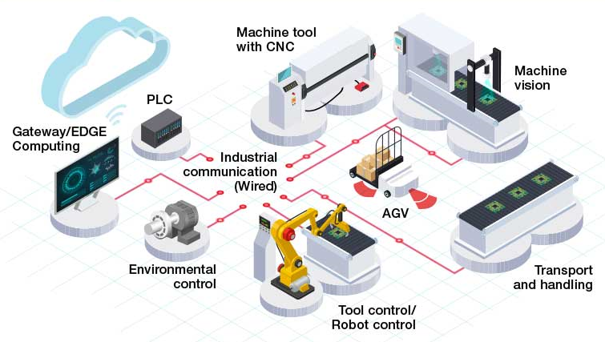
Communication and Integration
Industrial robots can be integrated into larger automated systems and communicate with other machinery or devices, such as conveyors, sensors, and control systems. This allows for synchronized operation and coordination with other equipment.

Slide 12
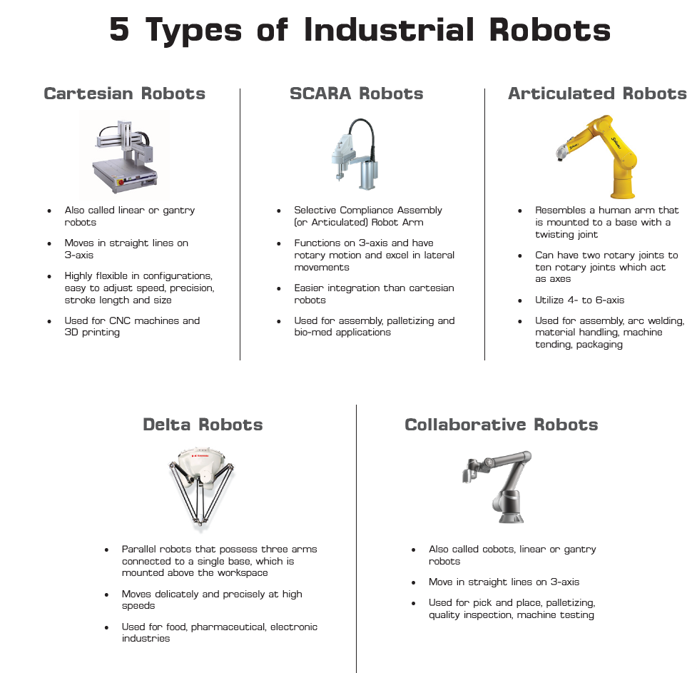
Types of Robots

Slide 13
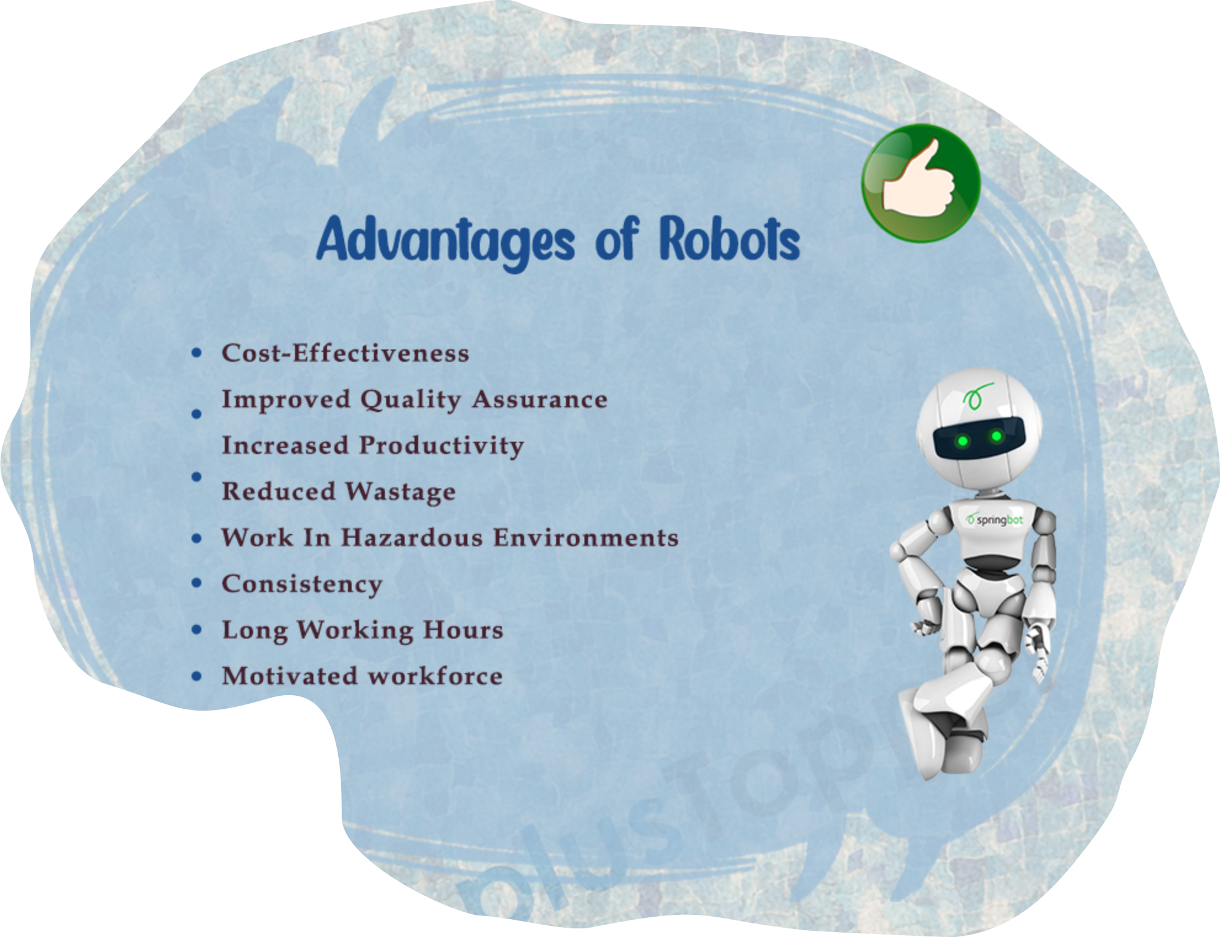
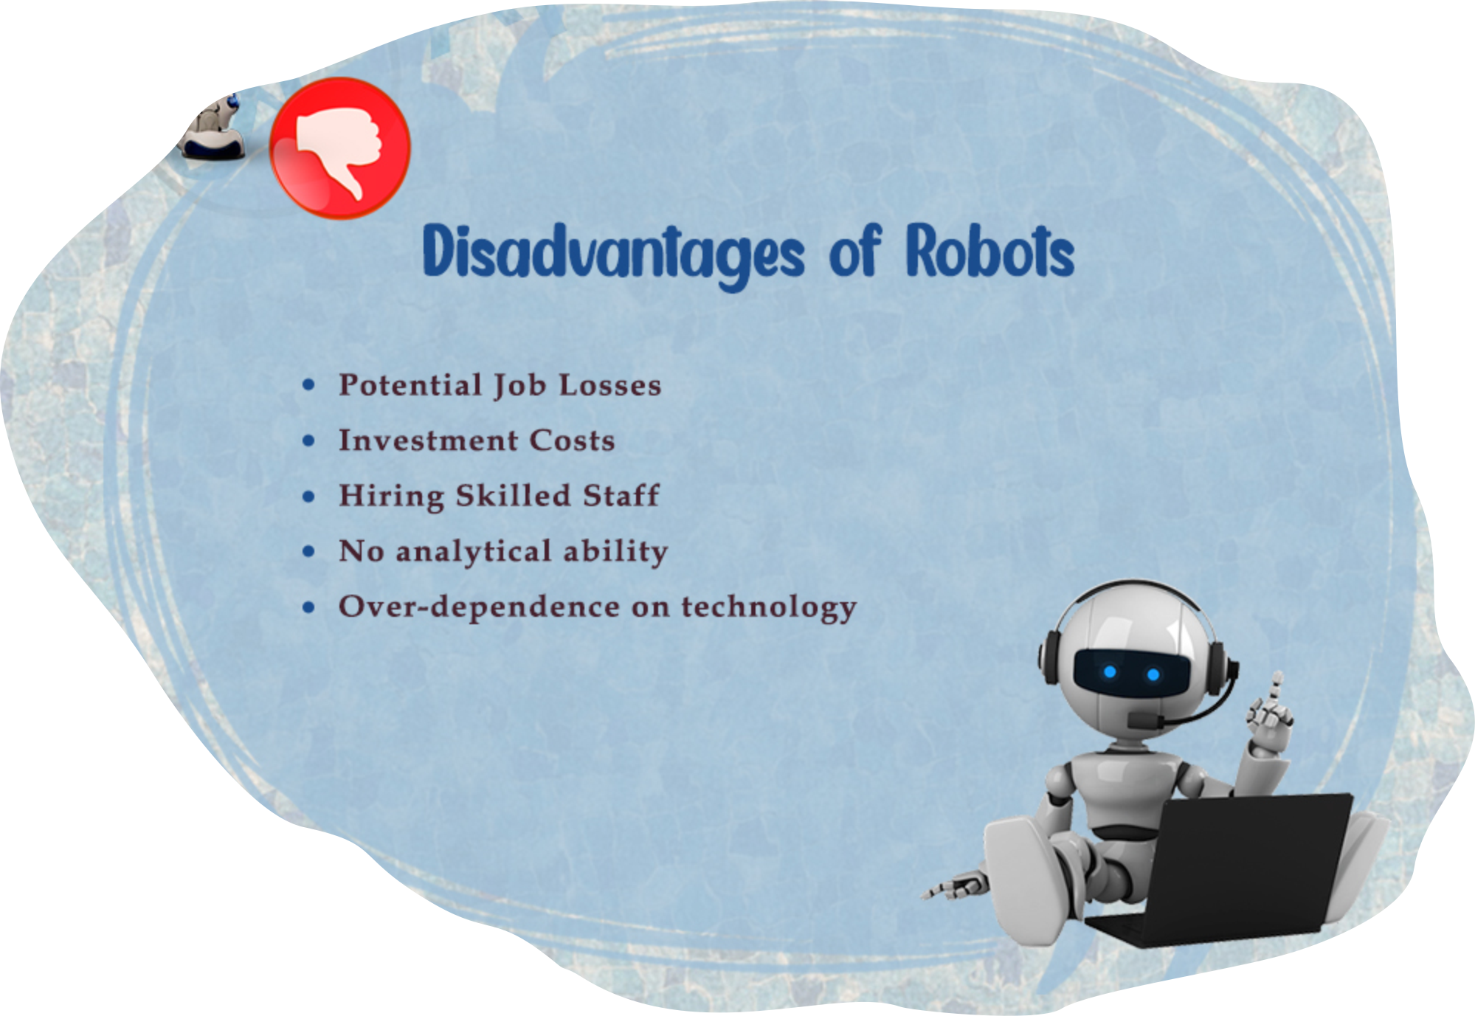
Advantages and disadvantages

Slide 14
Industrial robots play a significant role in modern manufacturing and industrial processes.

Slide 15
Here are some of their key significance and roles:
Automation and efficiency
Increased production capacity
Quality improvement
Workplace safety
Cost reduction
Flexibility and adaptability
Human-Robot collaboration
Skilled labor shortage
Innovation and technological advancement

Slide 16
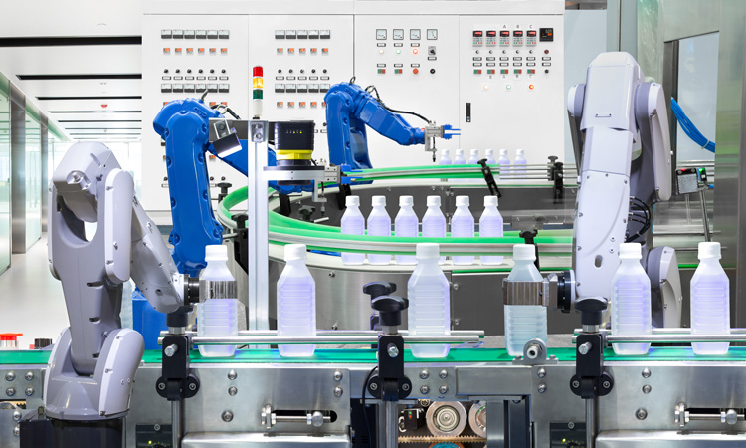
Automation and efficiency
Industrial robots are designed to automate repetitive and labor-intensive tasks, leading to increased efficiency and productivity. They can perform tasks with precision and consistency, eliminating human error and reducing production time.

Slide 17
Increased production capacity
Robots can work tirelessly without the need for breaks or rest, leading to improved production capacity. They can operate 24/7, enabling manufacturers to meet higher demands and improve their competitiveness.

Slide 18
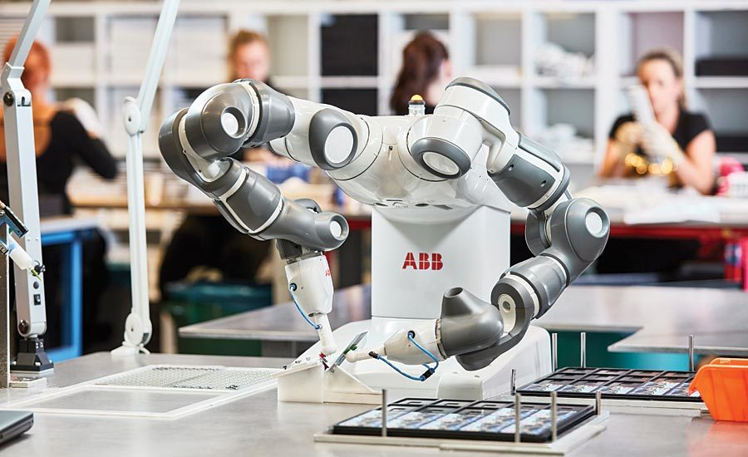
Quality improvement
With their precise movements and consistent performance, industrial robots help improve product quality. They can carry out tasks such as welding, assembly, and painting with high accuracy, reducing defects and ensuring uniformity.

Slide 19
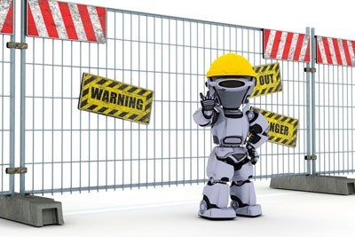
Workplace safety
By taking over hazardous tasks, robots help enhance workplace safety. They can handle tasks that involve heavy lifting, exposure to toxic substances, or working in harsh environments. This reduces the risk of accidents and injuries for human workers.

Slide 20
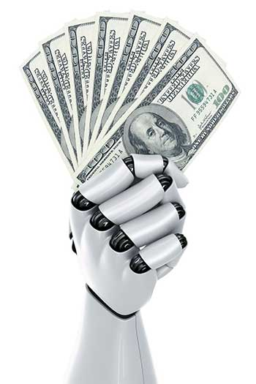
Cost reduction
While the initial investment in industrial robots can be significant, they can lead to long-term cost savings. Robots can perform tasks more efficiently, reducing labor costs and minimizing waste. Additionally, their improved accuracy reduces material waste and rework.

Slide 21
Flexibility and adaptability
Modern industrial robots are designed to be versatile and adaptable to different tasks. They can be programmed and reprogrammed to perform various operations, allowing manufacturers to quickly switch between different products or production lines.

Slide 22
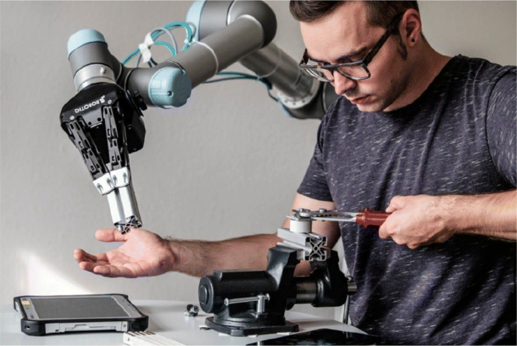
Human-Robot Collaboration
Collaborative robots, also known as cobots, are designed to work alongside humans. They can assist workers in tasks that require human dexterity or decision-making, leading to improved productivity and job satisfaction.

Slide 23
Skilled labor shortage
In many industries, there is a shortage of skilled labor. Industrial robots can fill the gaps by performing tasks that require specialized skills, allowing human workers to focus on more complex and value-added activities.

Slide 24
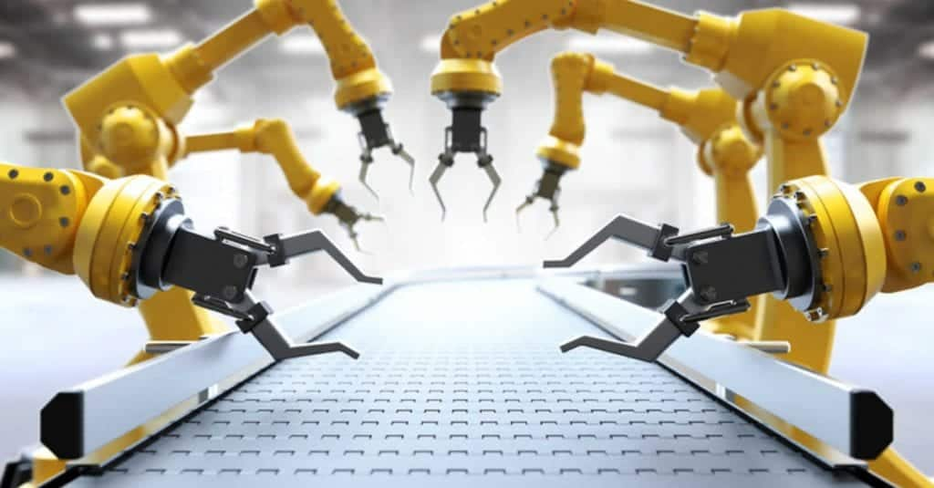
Innovation and technological advancement
The development and implementation of industrial robots drive technological innovation. As robots become more advanced, they push the boundaries of automation, artificial intelligence, and robotics, leading to advancements in various industries.

Slide 25
Industrial robotic is a rapidly evolving field, and new technologies and advancements continue to emerge, making robots more versatile, intelligent, and adaptable to different industries and tasks.
Industrial robots significantly contribute to increased productivity, improved product quality, enhanced workplace safety, cost reduction, and technological advancement. They play a vital role in transforming manufacturing and industrial processes, making them more efficient, competitive, and adaptable to changing demands.

Slide 26
THANKS!
Any questions?

