Slide 1


Processing commands in the leader diagram

Slide 2
Field | Automation and robotics
Chapter | Processing commands in the leader diagram
Subtitle | General

Slide 3
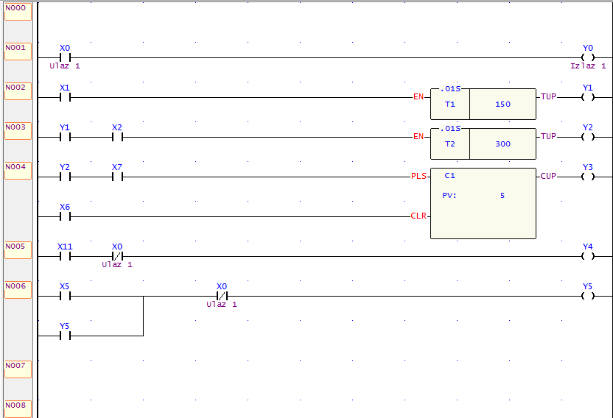
Ladder diagram
Ladder diagram programming is a graphical programming language used for programming programmable logic controllers (PLCs). It is widely used in industrial automation and control systems.
Figure 1. Ladder diagram in FATEK PLC

Slide 4
Ladder diagram
In ladder diagram programming, the program is created using ladder logic symbols that represent various instructions and operations. These symbols are arranged in a ladder-like fashion, hence the name "ladder diagram." The ladder diagram is executed from left to right, top to bottom, just like electrical circuits are read.
In a ladder diagram, there are several symbols used to represent different commands and instructions. Here are some commonly used symbols for commands in a ladder diagram:
Normally Open (NO) Contact
Normally Closed (NC) Contact
Coil
Timers
Counters

Slide 5
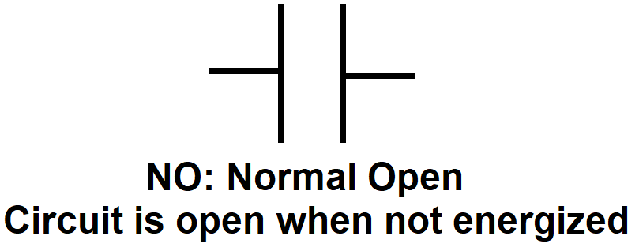
Commands in a ladder diagram
    Normally Open (NO) Contact: It represents a normally open contact, which is a condition or input that must be true for the circuit to continue. It is typically represented by two parallel lines with a gap or a diagonal line.

Slide 6
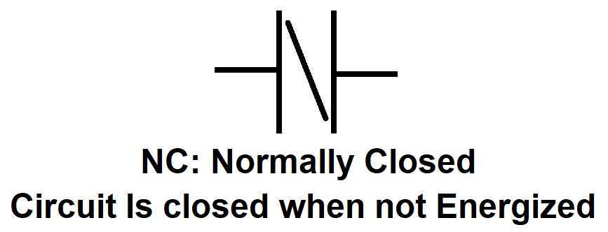
Commands in a ladder diagram
Normally Closed (NC) Contact: It represents a normally closed contact, which is a condition or input that must be false for the circuit to continue. It is typically represented by two parallel lines that are connected.

Slide 7
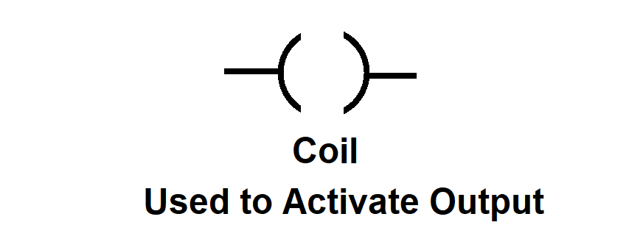
Commands in a ladder diagram
Coil: It represents an output device or actuator, such as a motor, solenoid valve, or indicator light. It is typically represented by a rectangle with two vertical lines extending from the sides.

Slide 8
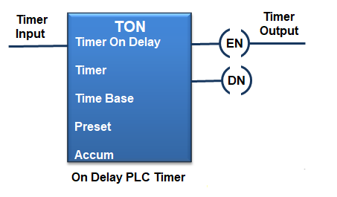
Commands in a ladder diagram
Timers: Timers are used to introduce time delays in the control logic. They can be represented by various symbols, but a common representation is a rectangle with a T inside. The timer symbol is connected to a coil or output to control the timing of the output.

Slide 9
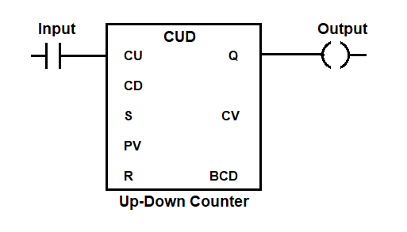
Commands in a ladder diagram
Counters: Counters are used to keep track of the number of events or pulses that occur. They are often represented by a rectangle with a C inside. The counter symbol is connected to a coil or output, and it counts the number of times the associated input condition is true.

Slide 10
Commands in a ladder diagram
To program a PLC using ladder diagram, you typically use specialized software provided by the PLC manufacturer. The software allows you to create, edit, and debug ladder diagrams. Once the ladder diagram program is created, it can be downloaded to the PLC for execution.
It's important to note that ladder diagram programming is just one of several programming languages used for PLCs. Other common languages include function block diagram (FBD), structured text (ST), and sequential function chart (SFC). The choice of programming language depends on the PLC manufacturer and the specific requirements of the automation system

Slide 11
THANKS!
Any questions?

Slide 12
Literature :
Script prof. Dr Milutin Petronijević “Predavanja iz specijalnih električnih mašina 2014-2015”, Elektronski fakultet u Nišu,
Script prof. dr Zoran Janković for subject Programabilno logički kontroleri

