Slide 1
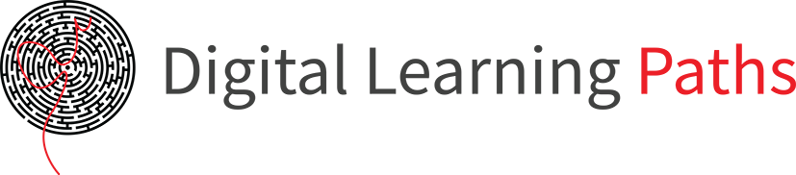

Field | Automation and robotics
Chapter | Management of transport systems
Subtitle | The management of transportation systems in industry

Slide 2
Management of transport systems

Slide 3
Management of transportation systems in industry refers to the planning, organization, and supervision of the transportation and logistics processes within industrial facilities. This involves managing the movement of materials, products, or resources within factories, warehouses, or other logistics facilities.

Slide 4
The management of transportation systems in industry aims to optimize the flow of materials and resources, reduce costs, improve efficiency, and increase productivity. This field encompasses a wide range of activities, including:

Slide 5
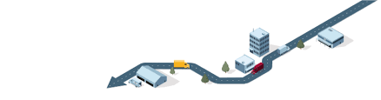
Route and scheduling planning
Managing transportation systems in industry involves planning optimal routes and schedules for the movement of materials or products within facilities. This may involve the use of sophisticated optimization algorithms to minimize travel time, reduce interruptions, and improve the utilization of transportation vehicles.

Slide 6
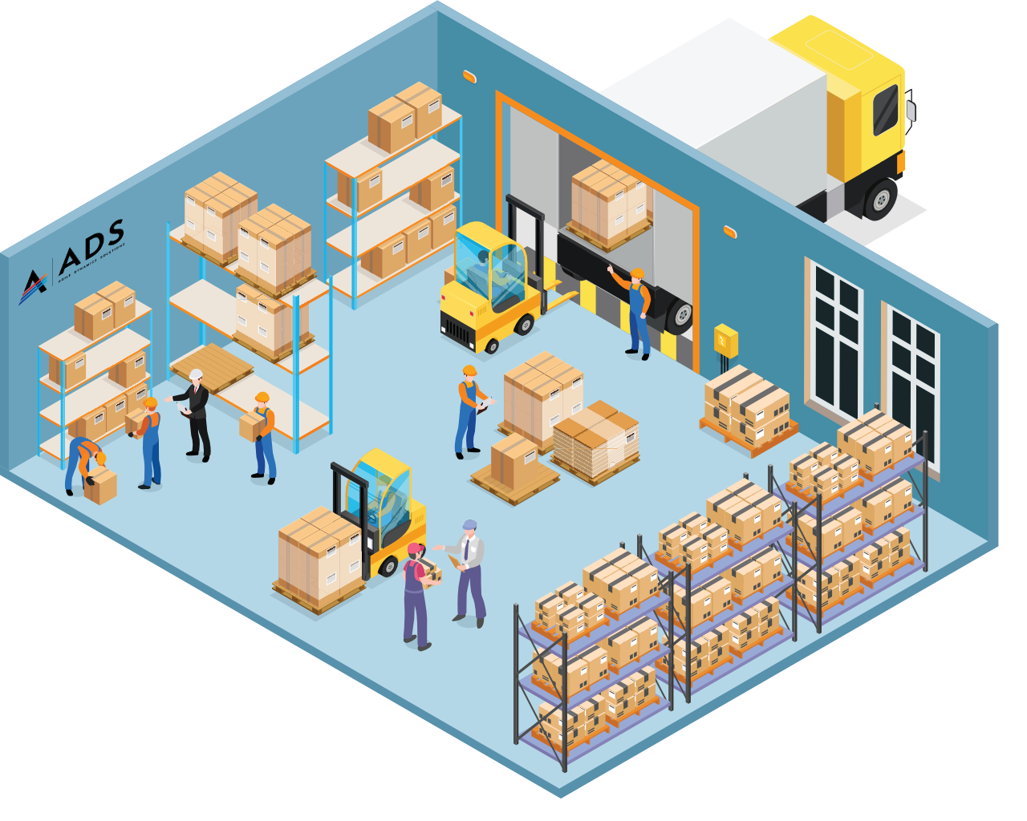
Inventory management
Efficient inventory management plays a crucial role in transportation systems in industry. This includes tracking and monitoring inventory, planning procurement and deliveries, as well as managing the warehouse to ensure continuous availability of materials and products.

Slide 7
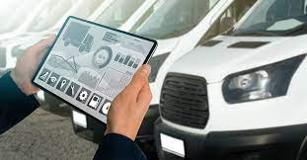
Vehicle and equipment management
This area encompasses the management of the vehicle fleet, including monitoring vehicle movements, maintenance and repairs, as well as optimizing their utilization. Managing transportation systems in industry may also involve managing other equipment such as conveyors, cranes, or robotic systems.

Slide 8

Information systems and technology
Effective management of transportation systems in industry requires well-integrated information systems and technology. This may involve using software tools for tracking, planning, and data analysis, as well as implementing automatic identification technologies (e.g., barcodes, RFID) for tracking and identifying materials and products during transportation.

Slide 9
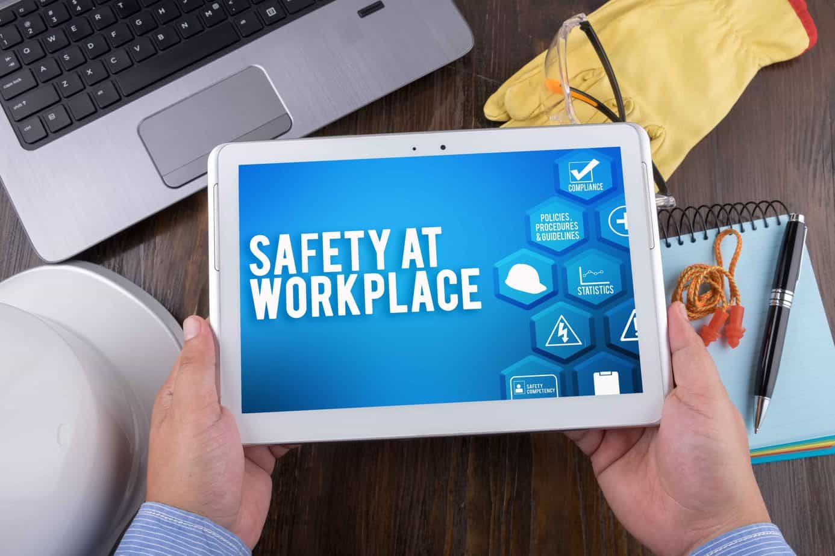
Safety and compliance
Managing transportation systems in industry also includes ensuring the safety of employees and compliance with regulations and standards related to transportation and logistics. This involves implementing safety protocols, training staff, and regularly maintaining equipment to minimize risks and ensure compliance with relevant regulations.

Slide 10
The management of transportation systems in industry is crucial for the efficient and successful operation of many industrial sectors, such as manufacturing, distribution, warehousing, logistics, and transportation. Advances in technology, including automation, artificial intelligence, and the Internet of Things (IoT), continuously contribute to improving the management of transportation systems and achieving greater efficiency and productivity.

Slide 11
THANKS!
Any questions?

