Slide 1


Field | Automation-Robotics
Chapter | Mechatronics
Subtitle | PLC Programming

Slide 2
Summary
This paper deals with programmable logic controllers that have become the basis of today 's modern industry and automation. Programmable logic controllers (PLCs) have improved the control system and replaced the previous system, which was based on electromechanical relays. This paper deals with the programming languages used in the programming of PLC devices and the basics and characteristics of each individual programming language are listed. In the second part of the paper, a practical example of automatic garage door control is given.
Glossary: automation, production process, control system, programmable logic controllers, programming

Slide 3
1. PLC DEVICE PROGRAMMING
1.1. Program testing - real state simulation
1.2. Ladder diagram - LD
1.3. Statement list - STL
1.4. Function block diagram - FBD
1.5. EXAMPLE OF GARAGE DOOR MANAGEMENT
1.6. CONCLUSION
2. REFERENCES

Slide 4
1. PLC DEVICE PROGRAMMING
As PLC devices developed and upgraded over time, programming languages developed in parallel with them. Programming languages allow users to create a control program for an automated system controlled by a PLC device. The PLC device then executes the program code and controls a certain process according to its instructions, ie. manages inputs and outputs.
Program writing is mostly performed on personal computers that have software support for a specific PLC device. As there are many manufacturers of PLC devices on the market today, each manufacturer delivers the appropriate software, which consists of:
• Text editor, which is used to write the user program, line by line,
• Compiler, which checks the syntax of written program code,
• and communication software, which is used to transfer correctly written program code from a personal computer to the RAM memory of the PLC device.
Another way to program a PLC device is via manual programmers that connect to the PLC device. Handheld programmers have a small LCD screen and keyboard. They are mainly used for minor program changes when it is necessary to do it immediately and on the spot, in the plant.
Also, there are PLC devices that have a small LCD screen and several function keys. Such small PLCs are used to program some simpler processes.

Slide 5
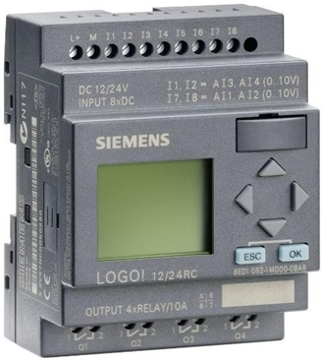
Figure 4.1 - Siemens LOGO!

Slide 6
1.1 Program testing - simulation of real states
In order for the PLC programming process itself to be successful, it is necessary to examine the written program in some way. The testing is performed in a way that the states of quantities that correspond to those from the real conditions in the process itself are brought to the inputs. So-called state simulators are used for this way of testing programs. The state simulator is actually a series of switches at the input that change the state in the case of digital inputs, or a potentiometer in the case of analog inputs, and control lamps (LEDs) at the output.
How does it work? When e.g. we want to test the operation of the antifreeze sensor, which switches when the temperature being measured falls below zero (0ºC), we put a switch in its place which we switch and it now simulates instead of the sensor that the temperature has dropped below zero. If the expected output on which the control lamp is connected is activated and it lights up, it means that the expected scenario actually happened and the simulation was performed successfully as well as the program testing.
Also, today, testing can be done in software, which is more practical because there is no need to make a simulator.
There are many programming languages for programming a PLC device. The most widely used method is programming with ladder or contact diagrams (ladder diagram). This way of programming dates back to the very beginnings of PLC devices, and is based on the adaptation of relay control schemes. In addition to ladder diagrams, there are also statement lists that represent assembler-level programming (text programming language) and function block diagrams - graphical programming that use logic blocks from Boolean algebra to display logic.
There is also the possibility of programming using BASIC and C programming languages, but these methods are not widely represented and everything remains within the possibilities.

Slide 7
2.2 Ladder diagram - LD
As already mentioned, ladder diagrams were created on the basis of electrical control schemes. They have been in use since the very beginning of PLC devices. The ability to program ladder diagrams is one of the main reasons for the success of PLC devices. The similarities between the way PLC devices are programmed with ladder diagrams and relay ladder logic, as used before in the management of production plants, facilitated the transition from the relay control system to systems controlled by PLC devices.
Comparing the circuit diagrams with the ladder diagrams of the PLC programming language, we see many similarities. The figure shows a diagram of a simple START - STOP electrical control circuit. The operation of the controlled device, in this case the motor, depends on the position of the button or auxiliary contact.

Slide 8
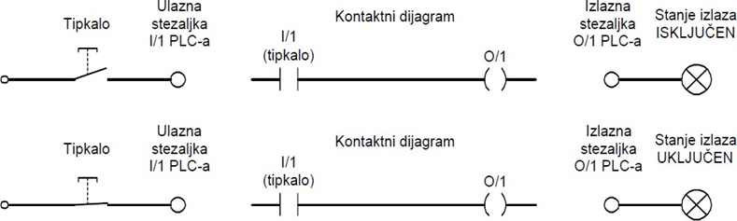
The ladder diagram is very similar to the electrical control circuit diagram. In the circuit diagram, the symbols represent the actual devices and their wiring, while in the ladder diagram they represent the commands in the program. Also, the circuit diagram shows the state of the contact (open / closed) while in the ladder diagram it is logically examined whether a command is true (true) which is logical ´1´ or false (false) which is logical ´0´.
Each logic path in a ladder diagram has at least one output command, and in order for it to execute at least one or more conditions must be satisfied. Conditions are signals that the PLC device processes from the input. On the right side of the logic path is an output command that has the status ON / OFF, depending on the state of the conditions. In the following figure we can see an example of a logic path in a ladder diagram showing the dependence of the output on the input.
Figure 4.3 –Ladder diagram example

Slide 9
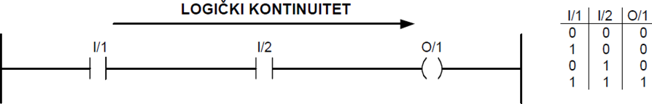
We can reduce the programming of the ladder diagram to two basic combinations of logical commands ´AND´ and ´OR´ and their derivatives.
The following figure shows an example of two serially connected logical commands ´AND´. In order for the output to be activated, both logical conditions must be met. If only one of the two logic conditions is in the ´0´ state, the logical continuity is interrupted and the output will not be activated.
Figure 4.4 - ladder diagram of logic operation 'I'

Slide 10
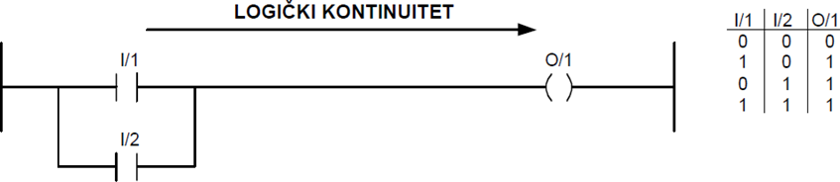
If two commands are connected in parallel, we get a ´OR´ logical operation. The output will be activated if one of the two conditions is met. When neither of the two conditions is met, logical continuity is lost and the output will not be activated, as shown in the following figure:
Figure 4.5 - Ladder view of the logical operation 'OR'

Slide 11
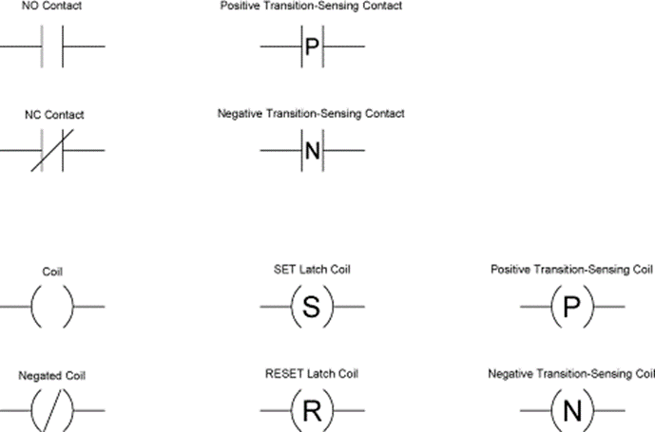
By combining basic logical operations, we can derive the entire Boolean algebra, which gives us many possibilities in programming itself. Programs mainly consist of several logic circuits and it should be emphasized that the program is run from top to bottom, from the first logic circuit to the last.
The following figure shows the basic symbols according to IEC 1131-3 and what they represent.
Figure 4.6 -Basic symbols used in the programming of the ladder diagram

Slide 12
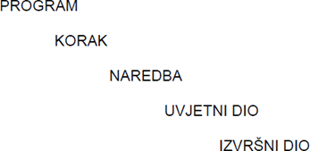
1.3 Instruction list - STL
A statement list is a programming language intended for programming PLC devices using assemblies at the assembly language level. Each line of code represents one command for the processor. The program hierarchy can be presented as follows:
Figure 4.7 - Hierarchy of programs written by instruction sheets

Slide 13
The program consists of a series of steps. The steps are performed in order, from the first to the last. The step represents a logical block within which some part of the program code is written, ie. a set of commands. Orders are given so that they have a conditional and an executive part.
The conditional part contains one or more conditions whose condition is checked during the program. The conditional part begins with the word ´IF´ followed by the conditions being checked, while the executive part begins with the word ´THEN´. Finally, this means that if the conditions in the conditional part of the command are met, the logical state is sent to the executable part which then executes the assigned tasks.
Step-by-step programming has one rule that determines the course of the program, and it reads: "If the conditional part of the last sentence within a step is not fulfilled and the executable part is not executed, the program does not go to the next step but returns to the first sentence of the same step." The program rotates in a loop until the condition from the last sentence is met. We can show this in the following diagram:

Slide 14
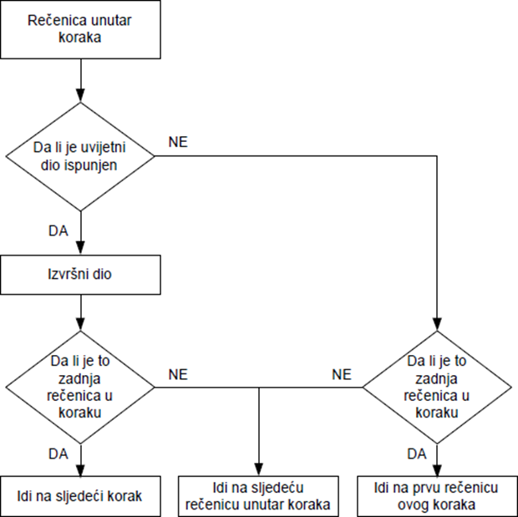
Since it is not always desirable for the program to rotate in a loop within one step, the command "NOP" is made, due to which the condition is always satisfied.
Other basic commands:
'=' - join command; 'SET' - sets the value of the bit size from ´0´ to ´1´; 'RESET' - sets the value of the bit size from ´1´ to ´0´; 'OTHRW' - if the conditional part is not satisfied, one part of the executive part is executed; 'AND' - logical ´and´; 'OR' - logical ´or´; 'XOR' - exclusively ´or´.
Basic mathematical operations (addition (+), subtraction (-), multiplication (*), division (/)) are used with the LOAD TO command.
Comparison commands (greater than (>), less than (<), equal to (=), greater than or equal to (≥), less than or equal to (≤), unequal (<>) always come in the conditional part with the IF THEN command.

Slide 15
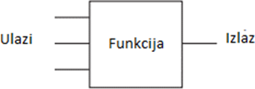
1.4 Function block diagram - FBD
Function block diagram is one of the graphical ways of programming PLC devices, just like programming with ladder diagrams. This programming language can be described as a graphical language for displaying the flow of signals and data through function blocks, which we can symbolically show in the following image:
Figure 4.9 - Function block

Slide 16
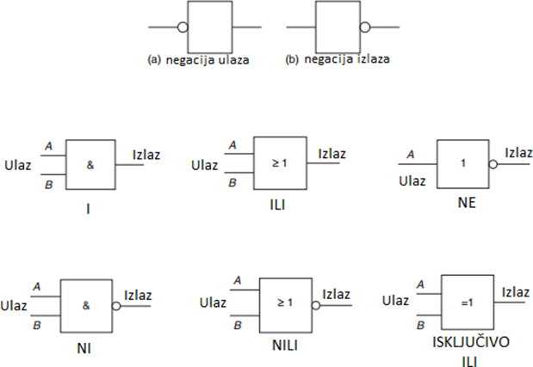
The function block is shown as a rectangular block with inputs on the left and output located on the right.
Function blocks can have standard functions such as timers or can be defined by the user.
The following figure shows the basic functions in this programming mode.
Figure 4.10 - Basic functions in a function block diagram

Slide 17
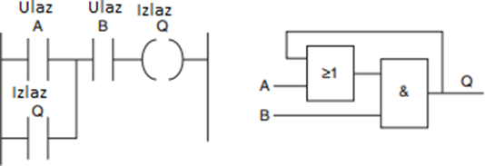
The functions with negated input and negated output are shown in the first row. Function
´I´ activates the output when both input A and input B give the result ´ TRUE´, which corresponds to logic ´1´. The “OR” function works by activating the output if either input A or input B is the same
"TRUE", ie. logical ´1´. The ´NO´ function activates the output if the input state is equal to the logic ´0´. By combining basic functions we can get derived functions like ´NI´,
´NILI´ and ´EXCLUSIVELY OR´.
In the picture we can see a ladder diagram showing the function where the output acts as an input. This same function is implemented in the function block diagram as feedback.
Figure 4.11 - Comparative presentation of ladder diagram and function block diagram

Slide 18
2. EXAMPLE OF GARAGE DOOR MANAGEMENT
Garage doors can be automated so that one does not have to worry about opening and closing them. The aim of this practical task is to design an automatic garage door control system and present the program code for its implementation.
The principle of operation is as follows: An ultrasonic sensor placed above the garage door detects an oncoming vehicle, which creates the conditions for lifting the door. As the vehicle passes through the door, the light beam emitted by the photoelectric sensor is interrupted and the system is signaled that the door can be closed securely. There are two more limit switches on the door; the upper one signaling that the door is fully open and the lower one signaling that the door is completely closed.

Slide 19
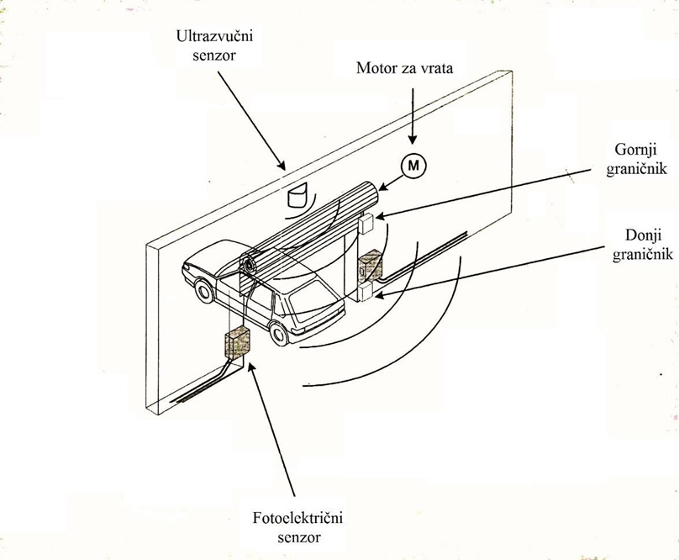
The first step towards programming such an automatic garage door control system would be to determine what are our input signals to the system (sensors) and what are our output signals from the system and give them names.

Slide 20
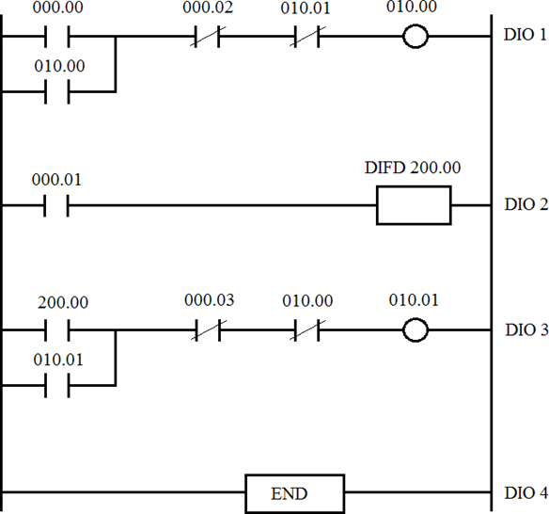
Login to the system:
• Ultrasonic sensor - 000.00
• Photoelectric sensor - 000.01
• Upper stop - 000.02
• Lower limit - 000.03 Outputs from the system:
• Door lift motor - 010.00
• Door lowering motor - 010.01
In the task, we will also use the DIFD (Differentiate Down) auxiliary instruction, which has the property to change the output state from 'OFF' to 'ON' during one cycle, and to set it to the 'OFF' state again.
The program code written in the ladder diagram for the presented problem looks like this:
Figure 5.2 - Program code - ladder diagram

Slide 21
In the first part (PART 1) the ultrasonic sensor (000.00) detects the vehicle which activates the output represented by the door lift motor (010.00). In order for the door to be raised, two more conditions must be met:
1. The upper stop (000.02) must be off which means that the door is in the lowest position,
2. The door lowering motor (010.01) must be switched off.
When all the conditions are met, the door begins to lift.
The passage of the vehicle through the door (PART 2) interrupts the beam of light emitted by the photoelectric sensor (000.01). An auxiliary signal (200.00) is set.
In the third part (PART 3) the auxiliary signal (200.00) serves as an entrance and signals that the vehicle has entered the garage and the process of lowering the door can begin (010.01). Before that, two more conditions must be met:
1. The lower stop (000.03) must be switched off, which means that the door is in the uppermost position,
2. The door lift motor (010.00) must be switched off.
When the conditions are met, the door lowers.
The last part (PART 4) of the code shows the end of the program cycle.

Slide 22
2. CONCLUSION
Today’s industry is almost unthinkable without automation. PLC devices have raised the ladder of automation to a whole new level. They threw out old relay systems that were cumbersome and inefficient. They shortened the idle speed in the production plants, which occurred when the mechanical relays would wear out or break down. They reduced the power consumption required to operate the system. Due to the speed of the PLC device, the cycle time on the machines has been reduced, which ultimately results in higher productivity.
This paper presents all the advantages of introducing such a management system in production facilities. The topic of hardware assemblies that make up one PLC device is covered. Each part is listed individually and the description states what function it has in the whole system. The principle of operation of PLC devices through four characteristic phases is explained. The programming languages used in the programming of PLC devices and the way in which these programs are created and finally tested are listed. I transferred the presented theoretical knowledge to a practical example of automatic garage door management where, step by step, I explained how to create and implement program code for such a simple automated system.

Slide 23
3.REFERENCES
1. Matić, N. (2001). Uvod u industrijske PLC kontrolere. mikroElektronika, Beograd.
2. Bryan L.A., Bryan, E.A. (1997). Programmable Controllers, An Industrial Text Company, Atlanta, SAD.
3. Bolton, W. (2006). Programmable Logic Controllers, Elsevier Newnes, Burlington, Velika Britanija.
4. Malčić, G., Programibilni logički kontroleri – interna skripta, Tehničko Veleučilište u Zagrebu, Zagreb.
Rajić, F. (2001)., Automatizacija postrojenja, Školska knjiga, Zagreb

Slide 24


