Slide 1


Field | Automation-Robotics
Chapter | Mechatronics
Subtitle | Programmable Logical Controlors(PLC)

Slide 2
Summary
This paper deals with programmable logic controllers that have become the basis of today 's modern industry and automation. Programmable logic controllers (PLCs) have improved the control system and replaced the previous system, which was based on electromechanical relays. This paper deals with a historical overview of the development of automated control systems and programmable logic controllers themselves. A comparison of automated systems controlled by PLC devices with those systems controlled by relays is given, and numerous advantages of introducing PLC devices into production processes are stated. A hardware assembly consisting of a single PLC device is listed. The principle of operation of the device itself is described in a simple way.
Glossary: automation, production process, control system, programmable logic controllers

Slide 3
1. INTRODUCTION 1
2. HISTORY OF PLC DEVICES 2
2.1. Features of the first PLC device 3
2.2. Advantage of PLC device control over classic relay control system 4
3. PLC DEVICE 5
3.1. Central Processing Unit (CPU) 6
3.2. Microprocessor 6
3.3. Power source 7
3.4. Communication interface 8
3.5. Device memory 8
3.6. Expansion modules 9
3.7. Inputs to PLC device 10
3.8. Outputs from PLC device 10
3.9. Principle of operation of PLC devices 11
4. REFERENCES

Slide 4
1. INTRODUCTION
The modern industry as we know it today is inconceivable without automation and automation. Under the term automation we consider the transfer of human labor to machines and it is closely related to mechanization. While mechanization frees a person from physically demanding jobs, automation replaces a person in physical and mental work.
Old production systems were guided by relay control composition. It was the connection of a multitude of electromechanical relays connected by wire. If the production process were to slightestly change, it would mean painstaking rearrangement and reconnection of the relay into one functional unit. During that time, production would stop and there would be idle time, which would mean huge losses for the company.
As the goal today is to be as productive and as profitable as possible, the relay control system did not fit into that story. Thus,the idea of a system controlled by a programmable logic controller - a PLC device was born. PLC devices have replaced the old control system and set a new standard in the modern industry. The main feature of these systems is that they are modular and flexible, so they can quickly adapt to today's dynamic production.
The first part of this paper will discuss the development of automated systems throughout history and the beginnings of control systems based on programmable logic controllers. We will also make a comparison between relay control systems and PLC-controlled systems, and highlight the important advantages of switching to a new control system.
In the second part of the paper, we will list which components make up a complete PLC controller, what their characteristics are and how it all works.
Next, we will mention how PLC devices are programmed, what are the programming languages used in PLC device programming and what are their advantages and disadvantages. In the last part of the paper, we will create a practical task, an example of automatic control of garage doors, which will briefly show everythingwrittenaboutPLCdevices.

Slide 5
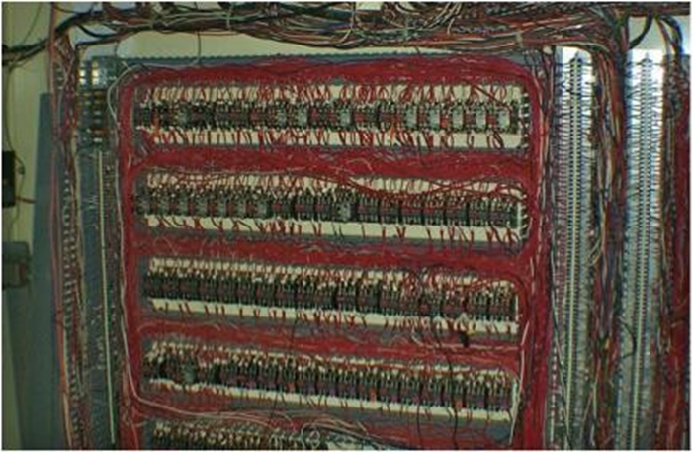
2. HISTORY OF PLC DEVICES

Slide 6
2.1. Features of the first PLC device
The new device provided the functionality that relay circuits had performed until then, replacing their wired logic. They were also modular and expandable as needed. The devices were easy to implement in a demanding industrial environment and were easy to use. The biggest advantage of the new device was that it did not require learning a new programming language to use it. It was programmed in a language that engineers and electricians already knew - the ladder diagram. The device was originally called PC Controller (Programmable Controllers).
With the advent of personal computers, programmable controllers are called programmable logic controllers (Programmable Logic Controllers) to avoid confusion among end users. In a very short time, PLC devices became widely accepted and began to be used to guide the production process in other industries,especially in the food industry.

Slide 7
2.2. The advantage of controlling PLC devices over a classic relay control system
Compared to a classic relay system, wiring is reduced by 80%
• The power consumption required for management is also greatly reduced
• PLC's self-diagnostic function allows quick problem detection and troubleshooting
• Due to the speed of the PLC, the required time for one cycle was reduced, which led to an increase in productivity
• Reprogrammability
• Greater system reliability
• Simple and easy storage and storage of programs
• In complex systems, where the control functions are complex and the number of inputs / outputs is large, the cost-effectiveness of using PLC systems increases compared to the classic relay control system

Slide 8
In the late sixties and early seventies, with the flourishing of industrial production, there was a need to improve the industrial plants and the processes that take place in them. The main reason was to improve working conditions and quality, increase productivity and flexibility. At that time, industrial plants were operated by systems based on relay cars. It was a huge system that contained a multitude of electromechanical relays, sometimes over a hundred, physically connected by wires. Thus, the engineer would design the entire logic of the control system while the electrician would connect all these relays according to the schematic logic plan.
The biggest drawback of this system is in the relays themselves. Relays are mechanical devices, and mechanical devices contain moving parts that are subject to wear and tear. If only one relay "fell out" of the system, it was necessary to check the whole system to find a worn out relay and replace it with a new one. The assembly would be out of order during that period, as would the production. Furthermore, if the production parameters were to change in the slightest, adjustments to the control systems would have to be made. This again required the entire design of the new system and the painstaking connection of many relays. The result was idle production, which resulted in a loss of production time and huge losses for the company. Potential problems would be if the engineer designed the system poorly or the electrician did not connect the system properly or if a mechanically defective relay was installed in the system. The only way to check the correctness of the system is to put the system into operation.

Slide 9
The slightest malfunction in the system would bring huge losses. It is not difficult to conclude that these systems were very "expensive" and inflexible. It was necessary to find a better solution for the automation of production plants.
Great competition in the automotive industry has forced engineers to think and be creative. The goal was to be as successful as possible in the market competition, and the American company 'General Motors' made the first step forward. There is an idea to implement an electronic - computer control system that would replace the existing inefficient system. Such a system could be reprogrammed by simply changing the production program, without long delays and without tedious relay connections. In 1968, the General Motors Hydromatic Division, part of General Motors, issued guidelines for the design of the first logic controller. The requirements were for such a microcomputer to be resistant to industrial conditions (elevated temperature, low temperature, dust, vibration, humidity, electromagnetic influences ...), to be easily programmed and to be able to be reprogrammed and reused for some other tasks. Following the guidelines, General Motors was looking for potential companies to develop the product. Gould Modicon was the first company to develop a device that met the issued specifications.

Slide 10
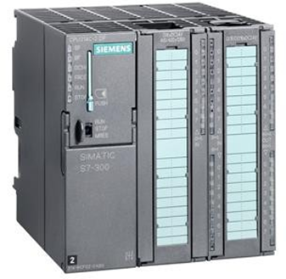
3. PLC DEVICE
In short, the PLC is a programmable logic controller, ie. an industrial computer invented primarily to replace existing sequential relay circuits in the management of industrial production plants. In the control system, the PLC is often called the heart of the control system.
Figure 3.1 - Siemens PLC SIMATIC S7 - 300

Slide 11
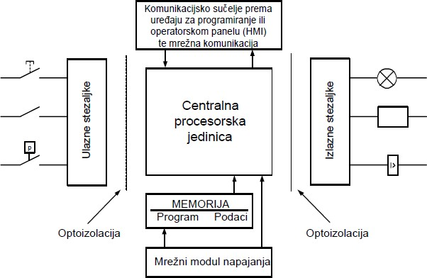
There are many devices on the market from various manufacturers, but their hardware structure is mostly the same. A typical representative of a PLC device consists of a central processing unit (CPU), input and output parts that can be digital or analog, a memory block, a network module used for power and communication, and an expansion module.
Figure 3.2 - PLC device scheme

Slide 12
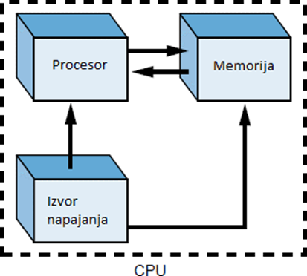
3.1. Central processing unit (CPU)
The central processing unit (CPU) is the most important element of a PLC device. It is the "brain" of the management system. It consists of three components: microprocessors, memory and power sources that interact with each other. Generally, a microprocessor runs a program that is stored in memory, while the power supply provides all the necessary voltage to ensure the smooth operation of the processor and memory. The architecture of the CPU can vary from manufacturer to manufacturer, but it all comes down to these three components.
Figure 3.3 - Scheme CPU

Slide 13
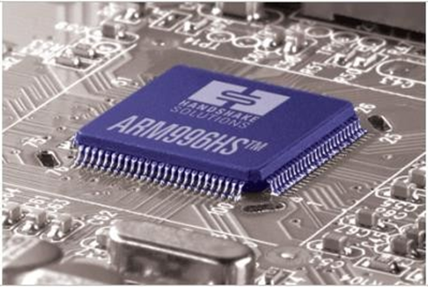
3.2 Microprocessor
The very small microprocessor housed in the CPU is actually an integrated circuit that has the amazing ability to compute and manage the entire system. Performs mathematical operations, manages operations, takes care of the interaction of other parts of PLC devices, executes programs specified by the user, monitors inputs and sets outputs based on them ... Microprocessors used in PLC devices categorized based on the length of records used in execution operation. Standard sizes are 8, 16 and 32 bits. The size of the record that the processor can process significantly affects the speed of operations. For example, a 32-bit processor performs operations much faster than a 16-bit processor because it processes twice as much data in a single operation.
Figure 3.4 - Microprocessor

Slide 14
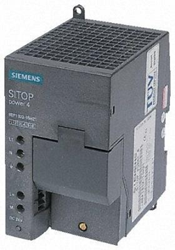
3.3 Power source
The power source is also one of the key elements of the whole system. Its role is not only to provide the required voltage for individual system components, but also to monitor and regulate the supply voltage and warn the CPU if something is not right. Most PLCs run on AC power, but some devices can also run on DC power. The required supply voltage is 220 VAC or 24 VDC. As in reality there are oscillations in voltage values, the power supply module must be able to tolerate ± 10% of the nominal amount. This means that if the voltage is 198 VAC and 242 VAC, the system should function normally. Anything outside the specified interval should report a processor error.
Figure 3.5 - Power supply device of PLC

Slide 15
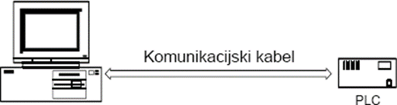
3.4 Communication interface
The main task of the communication interface is to communicate with the computer on which the driver is written. The program is forwarded to the PLC via a communication cable. The communication interface also offers us the possibility of connecting PLC devices with other PLC devices and various sensors. Communication is done through their internal connection.
Figure 3.6 - Schematic representation of the communication interface

Slide 16
3.5 Device memory
System memory is the place where all instructions and all user programs are stored. The entire system memory is divided into two segments: executive memory and user memory. Executable memory contains permanently stored programs and subroutines that are integral parts of the PLC device. These so-called monitoring programs are responsible for running user programs as well as communicating with input-output devices. This part of the memory is not available or visible to the end user. User memory is where user programs are stored. The user can access that memory and change the content.
As there are instructions and programs that must be permanently stored in memory, so there are data that are subject to change. Therefore, there are different types of memory on which data is stored:
• ROM (Read - Only Memory) is the memory on which data is stored permanently, without the possibility of change. They are immune to changes during a power outage. PLCs rarely use ROM.
• RAM (Random - Access Memory) is a memory designed in such a way that information can be written and read to it. It does not retain data if it runs out of power. RAM in a PLC is usually supported by a battery so that data is not lost after a power failure.

Slide 17
• PROM (Programmable read-only memory) is a special type of ROM memory that can be programmed only once. It is rarely used with PLC devices.
• EPROM (Erasable programmable read-only memory) is a special type of PROM memory that can be completely erased when exposed to UV light and reprogrammed.
• EAROM (Electricaly alterable read-only memory) is a memory similar to EPROM memory, only data is erased electrically instead of UV light.
• EEPROM (Electrically erasable programmable read-only memory) is a type of memory for permanent data storage. Data can be erased and reprogrammed electrically. So it offers permanent data storage that can be easily changed by a programmer. EEPROM memory is used in PLC devices.

Slide 18
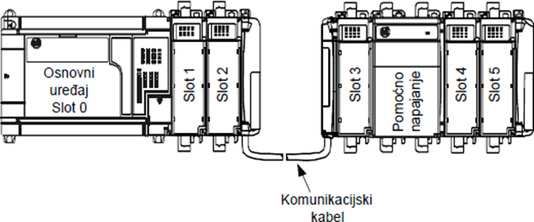
3.6 Expansion modules
Each PLC device has a limited number of inputs and outputs. If necessary, this number can be increased via the expansion module. The expansion module is a special device that connects to the PLC. It contains additional input and / or output terminals that may be of a different type from those on the PLC device. They are powered mainly from the PLC devices to which they are connected, although they may have a separate power supply, which is not recommended. The connection between the PLC device and the expansion module is made by a communication cable.
Figure 3.7 – Modue for extension

Slide 19
3.7 Inputs to the PLC device
The efficiency of the automated plant largely depends on the ability of the PLC device itself to read and process the data received at the input. The input to the PLC consists of connection screw terminals to which various types of sensors are connected and input devices. This is where the adjustment of the external signal, the signal from the environment to the signal understandable to the PLC processor takes place. Sensors used in automated drives are temperature sensors, pressure sensors, speed sensors, liquid height sensors, etc. Input devices through which human-PLC communication takes place are various switches, keys and keyboards. The signal that the PLC receives at its inputs can be digital and analog. An analog signal is e.g. voltage signal from one of the above sensors, while the digital signal may be a signal from input devices such as a switch or button.
Optoisolation is located between the input terminals and the central processing unit (CPU). The purpose of the optoisolation is to galvanically separate the input circuits of the input and the processor in order to prevent the flow of current due to potential differences in the circuits, and to prevent high-frequency interference by filtering the signal.

Slide 20
3.8 Outputs from the PLC device
The outputs of the PLC device are screw terminals to which the actuators are controlled. These are most often engines, sound and light signals, pneumatic distributors, etc. The outputs can be analog or digital. The digital output signal acts as a switch, while the analog output is used to generate an analog signal (e.g. regulating the motor speed over the amount of voltage corresponding to the desired speed).
Optoisolation is also located between the output terminals and the central processing unit (CPU) for galvanic isolation of the external and internal electrical circuit.

Slide 21
3.9 Principle of operation of the PLC device
The principle of operation of the PLC device can best be shown in the picture. The basis of the work is continuous scanning and data processing that takes place cyclically in an infinite loop.
The PLC device corrects the output state based on the input change, as determined by the logic in the user program. We have divided the whole cycle into four phases:
1. Input state processing - PLC checks each of the inputs (sensor, switch, etc.) and the data collected by the storage in the memory of the central processing unit.
2. Program processing - According to the state of input signals and based on the logic of the user program, the result is stored in the output memory register of the central processing unit.
3. Transferring the processed program to the outputs - The stored data from the output memory register, processed in the previous step, is forwarded to the outputs of the PLC device.
4. Processor organizational time and communication - The necessary operations for the proper functioning of the operating system and communication with external units are taking place.

Slide 22
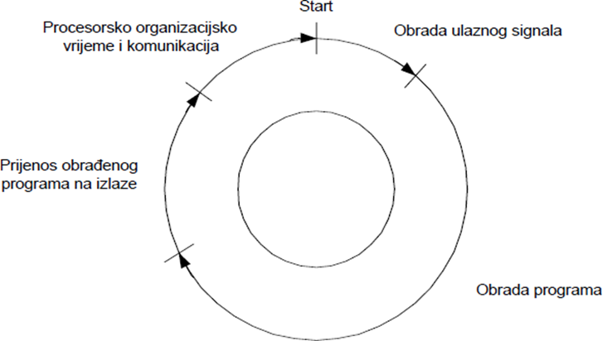
Figure 3.8 - Cyclus of operation of PLC device

Slide 23
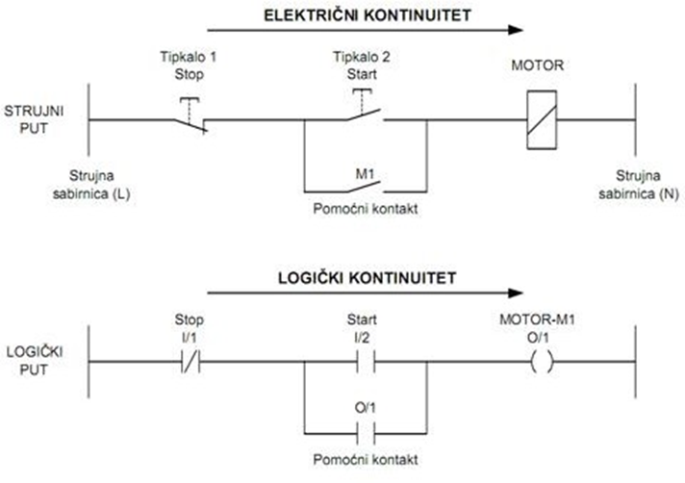
Figure 4.2 - Comparison of current and logic path

Slide 24
4.REFERENCES
1. Matić, N. (2001). Uvod u industrijske PLC kontrolere. mikroElektronika, Beograd.
2. Bryan L.A., Bryan, E.A. (1997). Programmable Controllers, An Industrial Text Company, Atlanta, SAD.
3. Bolton, W. (2006). Programmable Logic Controllers, Elsevier Newnes, Burlington, Velika Britanija.
4. Malčić, G., Programibilni logički kontroleri – interna skripta, Tehničko Veleučilište u Zagrebu, Zagreb.
Rajić, F. (2001)., Automatizacija postrojenja, Školska knjiga, Zagreb

Slide 25


