Slide 1


Field
Automation and robotics
Chapter
Analog inputs and outputs
Subtitle
General

Slide 2
Abstract
Automation, a multidisciplinary field integrating electronics, control systems, and information technology, relies heavily on analog inputs and outputs for efficient and precise control processes. This research paper explores the significance of analog signals in the realm of automation, focusing on their role in measurement, control, and communication systems. The paper also delves into the challenges and advancements associated with analog technologies in the context of modern automation

Slide 3
Introduction
Automation encompasses the design and implementation of systems that operate with minimal human intervention, relying on sensors, actuators, and controllers. Analog signals play a crucial role in this domain, serving as the bridge between the physical world and the digital realm.

Slide 4
Analog Inputs
Analog sensors are fundamental components in automation, providing continuous and real-time data about physical variables such as temperature, pressure, and position. These sensors convert physical quantities into analog electrical signals, allowing for precise monitoring and control. Examples include thermocouples, pressure transducers, and potentiometers.

Slide 5
Analog Inputs
Analog sensors are fundamental components in automation, providing continuous and real-time data about physical variables such as temperature, pressure, and position. These sensors convert physical quantities into analog electrical signals, allowing for precise monitoring and control. Examples include thermocouples, pressure transducers, and potentiometers.

Slide 6
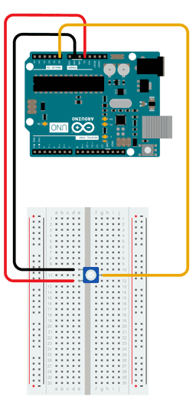
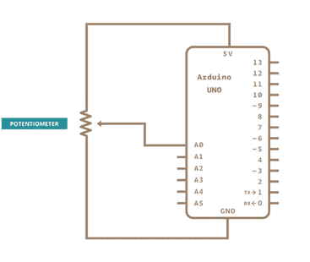
Analog Inputs
Analog Input with
ARDUINO controller

Slide 7
Analog Input CODE
int sensorPin = A0; // select the input pin for the potentiometer
int ledPin = 13; // select the pin for the LED
int sensorValue = 0; // variable to store the value coming from the sensor
void setup() {
// declare the ledPin as an OUTPUT:
pinMode(ledPin, OUTPUT);
}
void loop() {
// read the value from the sensor:
sensorValue = analogRead(sensorPin);
// turn the ledPin on
digitalWrite(ledPin, HIGH);
// stop the program for <sensorValue> milliseconds:
delay(sensorValue);
// turn the ledPin off:
digitalWrite(ledPin, LOW);
// stop the program for for <sensorValue> milliseconds:
delay(sensorValue);
}

Slide 8
Analog Outputs
Actuators, responsible for transforming control signals into physical action, heavily rely on analog outputs. Devices such as motors, valves, and heaters require analog signals to operate smoothly and achieve precise control. The seamless integration of analog outputs ensures that automated systems respond accurately to dynamic changes in their environment.

Slide 9
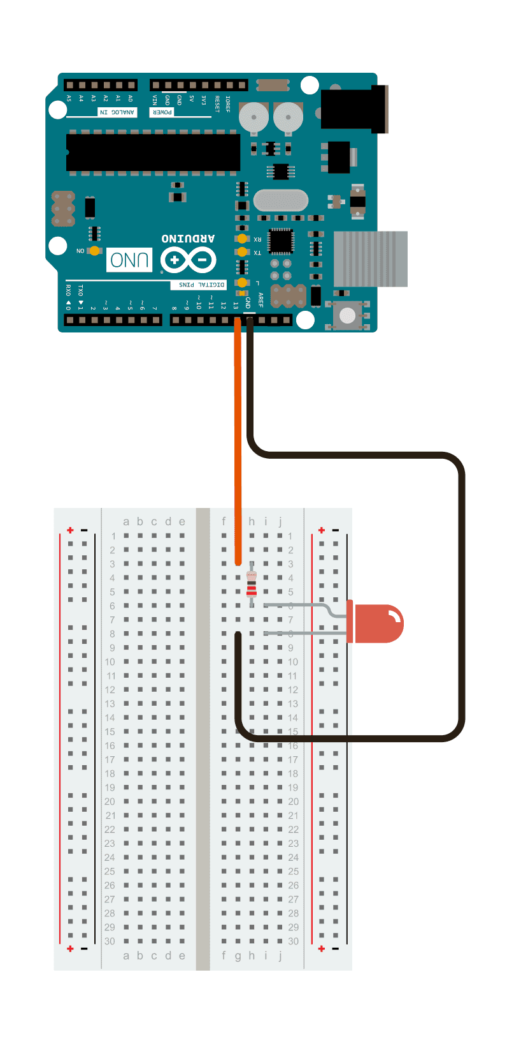
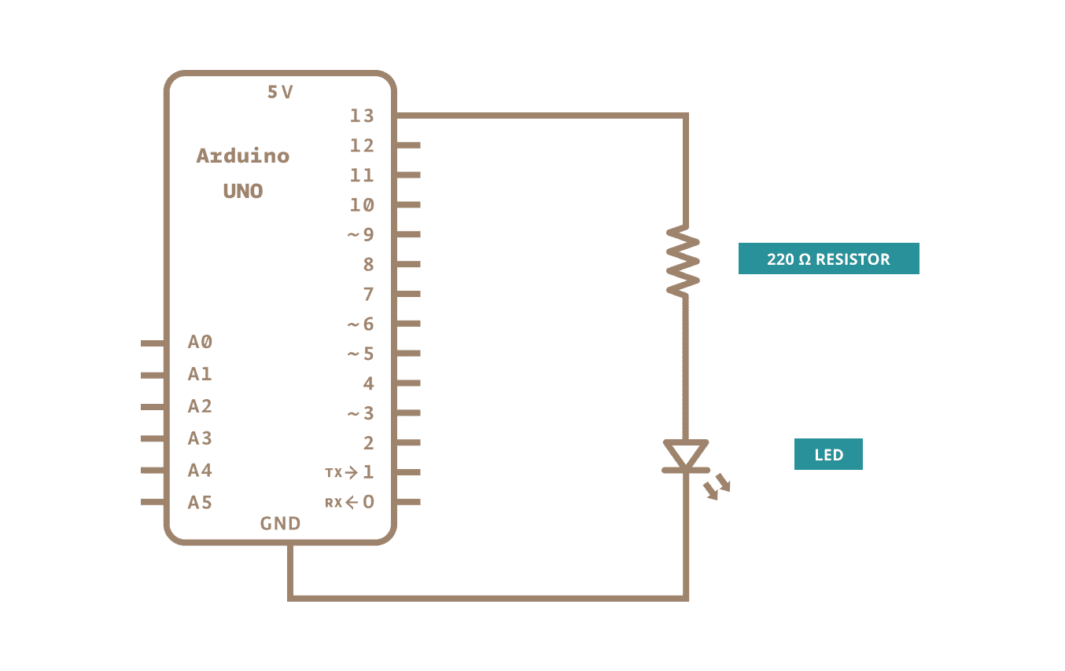
Analog Output
FadingLED with
ARDUINO controller

Slide 10
FadingLED CODE
int ledPin = 9; // LED connected to digital pin 9
void setup() {
// nothing happens in setup
}
void loop() {
// fade in from min to max in increments of 5 points:
for (int fadeValue = 0 ; fadeValue <= 255; fadeValue += 5) {
// sets the value (range from 0 to 255):
analogWrite(ledPin, fadeValue);
// wait for 30 milliseconds to see the dimming effect
delay(30);
}
// fade out from max to min in increments of 5 points:
for (int fadeValue = 255 ; fadeValue >= 0; fadeValue -= 5) {
// sets the value (range from 0 to 255):
analogWrite(ledPin, fadeValue);
// wait for 30 milliseconds to see the dimming effect
delay(30);
}
}

Slide 11
Challenges and Solutions
Despite the advantages of analog signals, challenges such as signal degradation, noise interference, and limited transmission range persist. Researchers and engineers are continuously addressing these challenges through innovations like signal conditioning, filtering techniques, and the use of robust communication protocols.

Slide 12
Challenges and Solutions
The integration of digital technologies, while expanding in the field of automation, has not entirely replaced analog systems due to their inherent advantages in certain applications. Hybrid systems, combining the strengths of both analog and digital technologies, are emerging as a solution to optimize performance and flexibility.

Slide 13
Future Trends
As automation continues to evolve, the role of analog inputs and outputs is expected to adapt to new challenges and opportunities. The integration of smart sensors, advanced signal processing techniques, and the development of more robust communication protocols will shape the future landscape of analog technologies in automation.

Slide 14
Conclusion
Analog inputs and outputs remain indispensable in the field of automation, providing the necessary link between the physical and digital aspects of automated systems. The continuous refinement of analog technologies, coupled with the integration of digital advancements, ensures that automation processes are more efficient, reliable, and adaptable to the ever-changing demands of modern industries.

Slide 15
References
Script with lectures at the Faculty of Electronics, Nis.
https://www.arduino.cc/

