Slide 1
Field | Automation and robotics
Chapter | Control systems
Subtitle | General

Slide 2
Control systems
CONTROL systems
Feedback
Test-functions
The bounce function
Impulse function
Slope function
L and L⁻¹ transformations
Harmonic function
System response to test functions

Slide 3
CONTROL systems
CONTROLLABILITY is the property of the system that, under the influence of control action, passes from one to another required state.
CONTROL EFFECT is an effect on the managed system or environment that improves the functioning or development of the system, which is selected from a set of possible actions, based on available information.
CONTROL PROCESS is the process of collecting, processing, distributing (but also storing, archiving and updating) information and its implementation in the form of executive activities.
CONTROL is a set of CONTROL processes that realize the system's goal function.

Slide 4
CONTROL systems
The CONTROL system contains two basic subsystems:
  Controled subsystem (CONTROL object)
  Control subsystem (control device, control subject)

Slide 5
Feedback
Feedback is a way of transmitting information about the realized or realized values ​​of the controlled quantity.
The realized values ​​of the controlled quantity are compared with the required (planned) values ​​in the comparator (adder).
Division:
  Positive feedback (increases the effect of the input on the output/controlled quantity)
  Negative feedback/coupling (reduces the influence of the input effect on the output/controlled quantity)ν

Slide 6
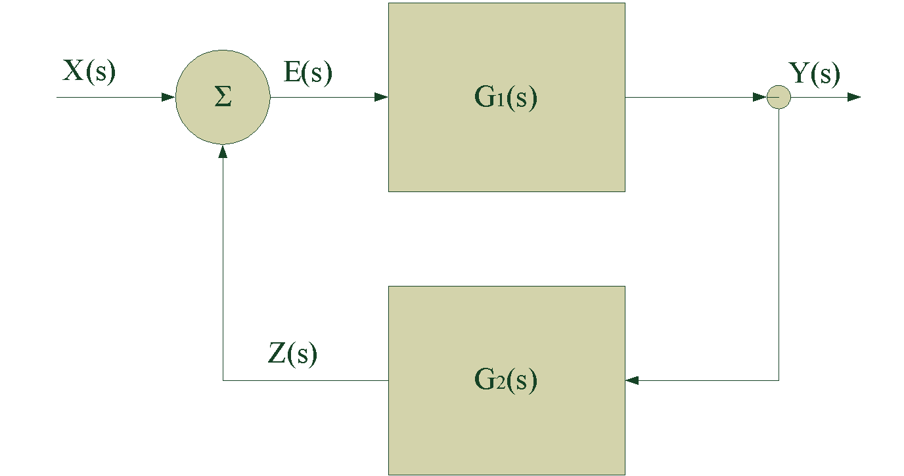
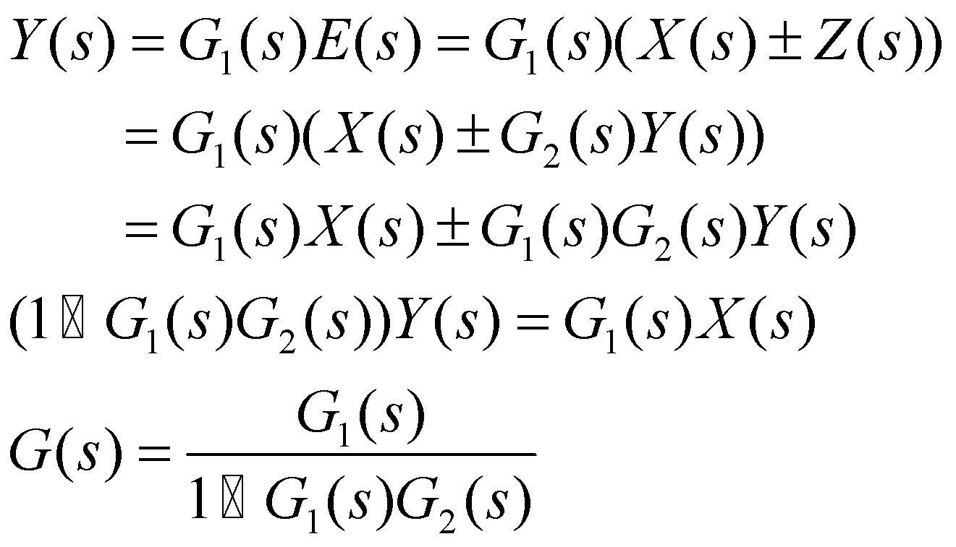
Feedback

Slide 7
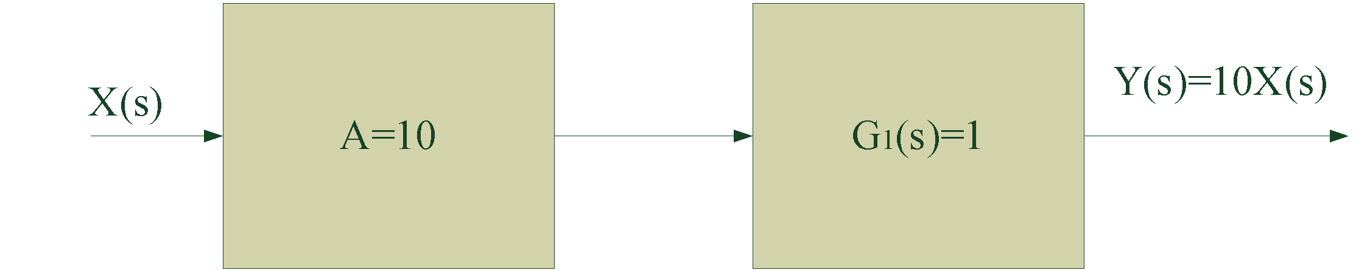
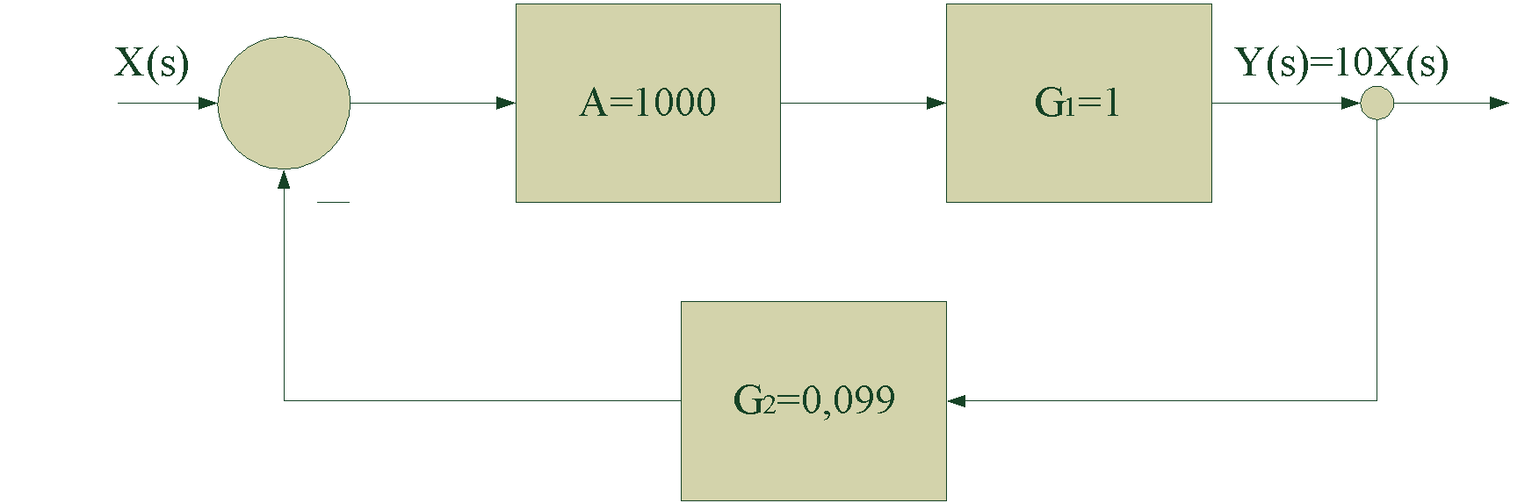
Feedback
Task: achieve 10 times amplified input signal at the output of the system
Open system
Closed system

Slide 8
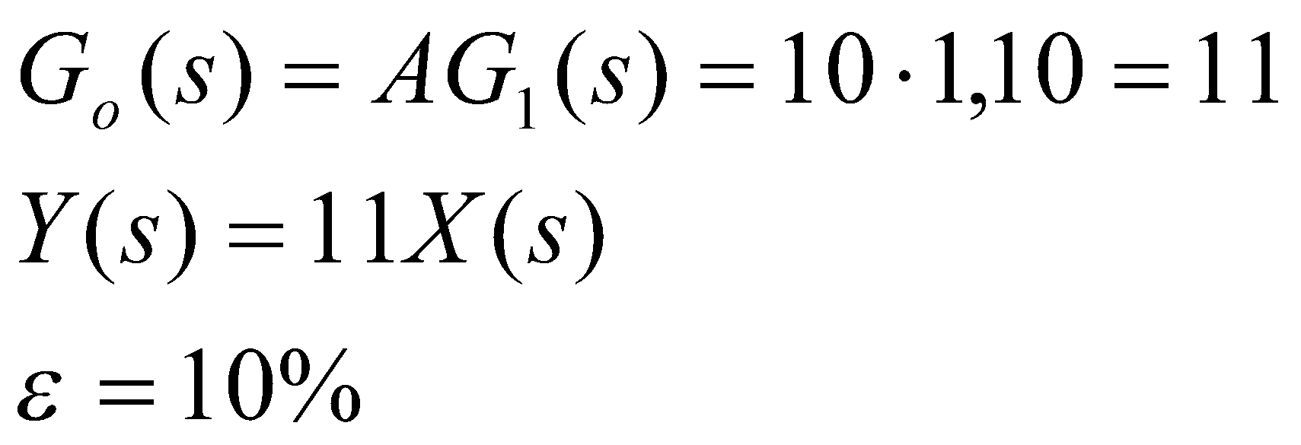
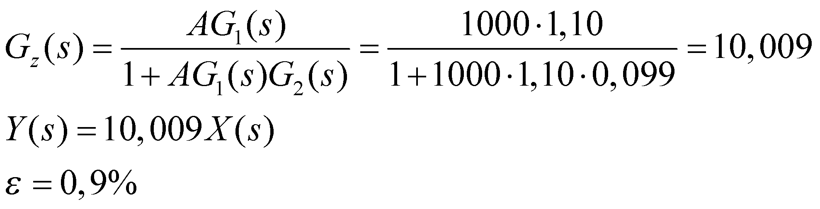
Feedback
Let the transfer function be changed to the value G1(s)=1.10
Open system
Closed system

Slide 9
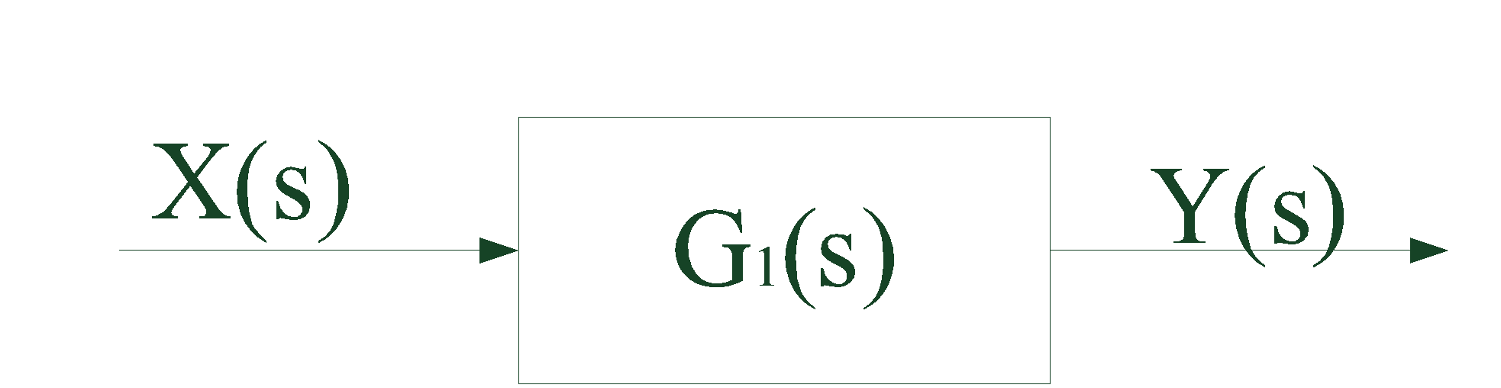
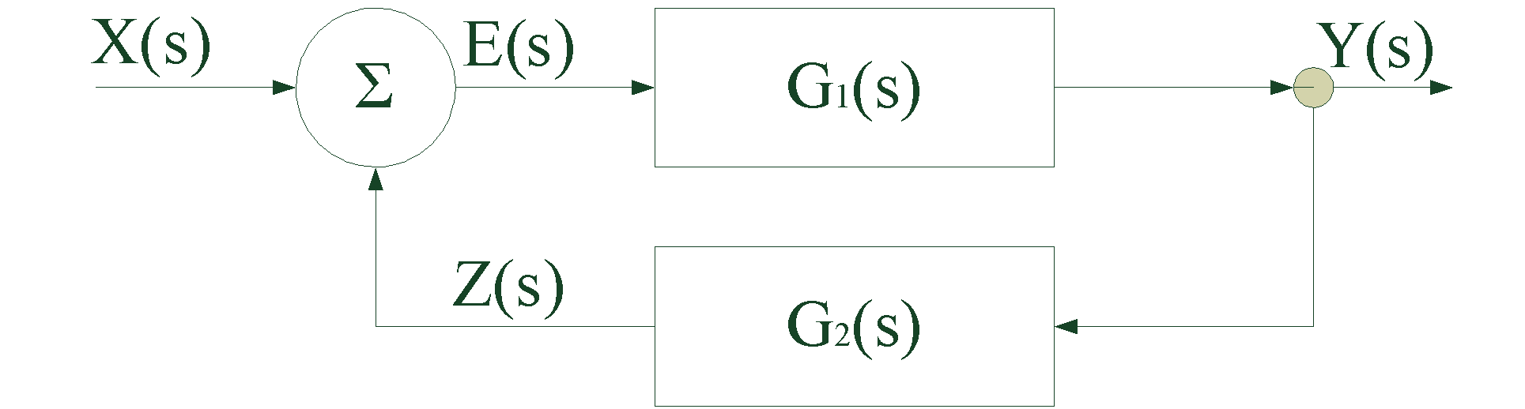
Feedback
The system shown in the picture under normal operating conditions performs an identical transformation of the input signal (G(s)=1), and under the influence of disturbances it changes the transformation operator to the value 0.8. Determine the transfer function of the feedback connection, as well as the values ​​of the output signals for the case of positive and negative feedback, if the input signal is X(s)=100

Slide 10
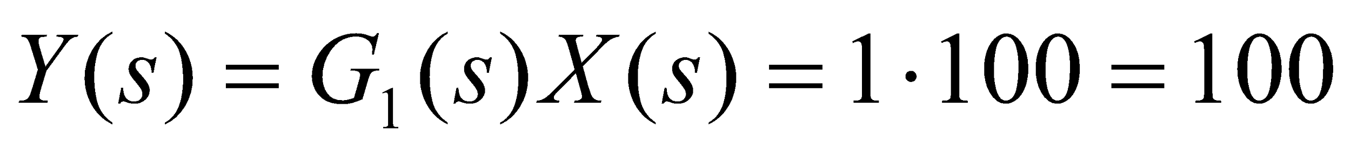
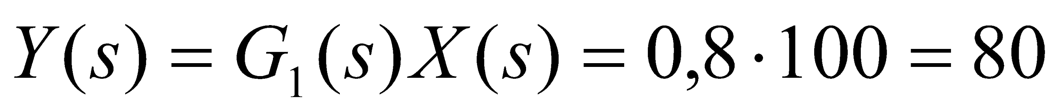
Feedback
When the system is not affected by disturbances, there is no need for feedback. The value of the open system output signal is
In the event of disturbance, the value of the output signal is reduced to the value
By introducing a feedback loop, which will have a corresponding transfer function, the existing value of the output (80) will change.

Slide 11
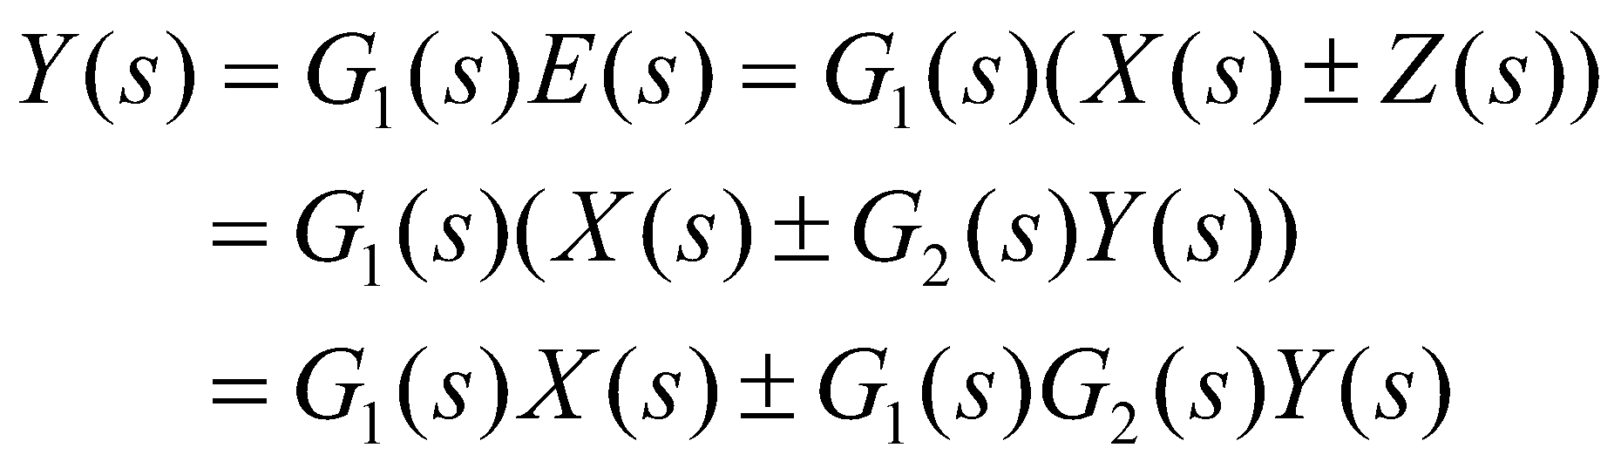
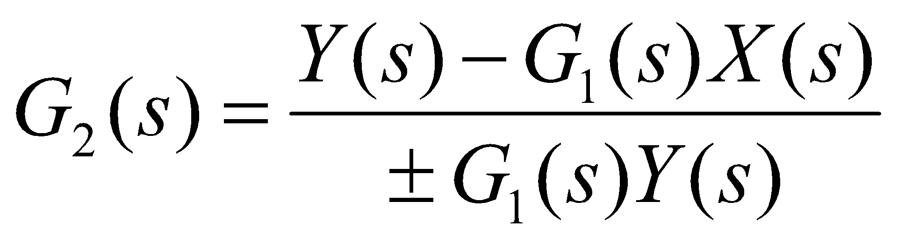
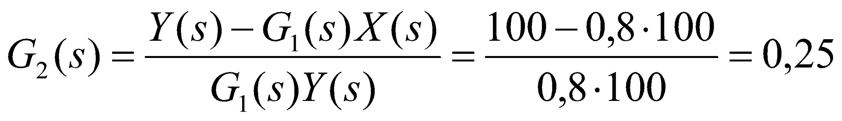
Feedback
For a feedback system:
Solving this equation by gives an expression on the basis of which the transfer function of the feedback connection is determined:

Slide 12
Feedback
The output signal for the positive feedback case will be:
and the output signal for the negative feedback case is:
Comparing the values ​​of the output signals in the system without feedback and in the systems with positive and negative feedback, it can be concluded that the positive feedback increases the effect of the input signal (the value of the output increases from 80 to 96), while the negative feedback reduces the effect of the input (the value of the output is reduced from 80 to 64).

Slide 13
Test-functions
The test function is a known input quantity (function) that serves to test the behavior of the elements, that is, the control system.The most frequently used test functions are:
  rebound,
  impulse,
  inclined i
  harmonic function.

Slide 14
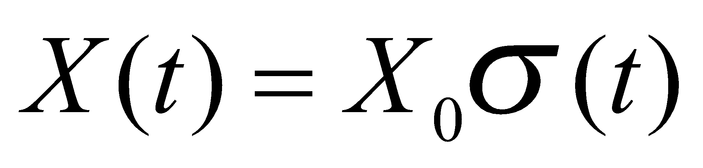
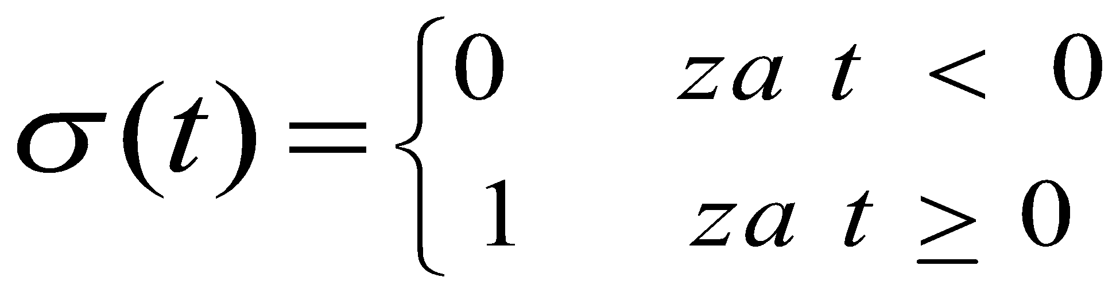
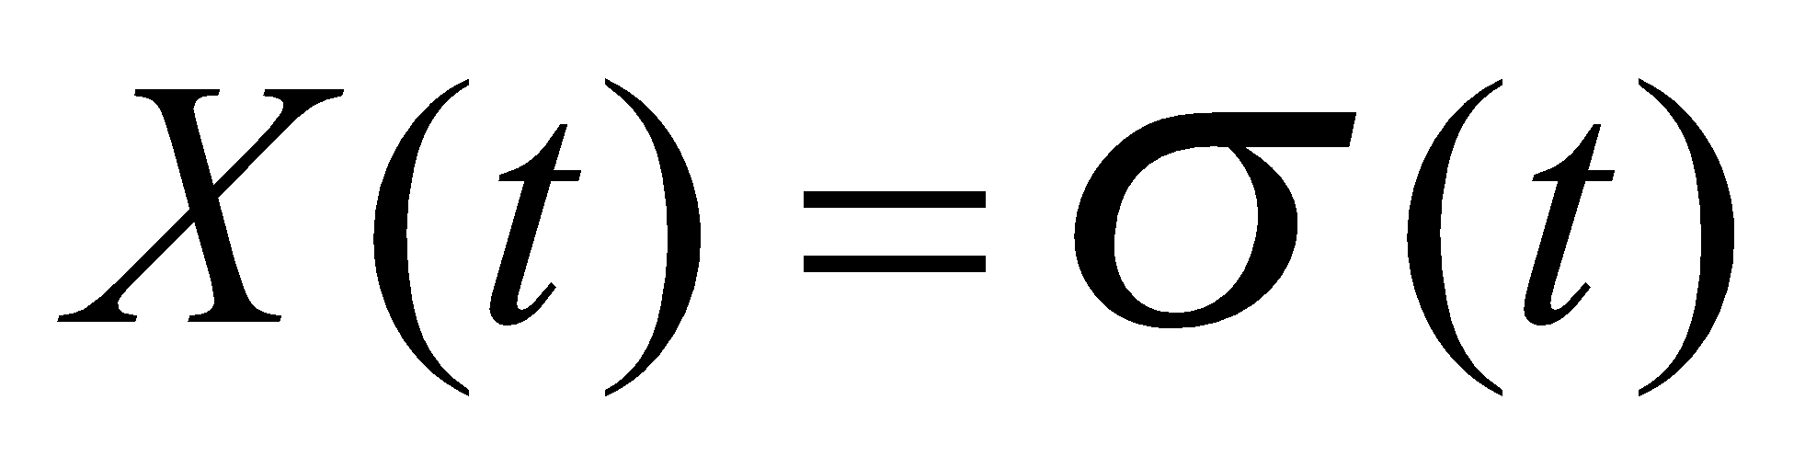
The bounce function
The bounce function is defined by the relation:
wherein:
  X₀- constant amplitude
  σ(t)- unit jump function, defined as follows:
  For X₀ =1 the jump function becomes:
  and is called the unit jump function.

Slide 15
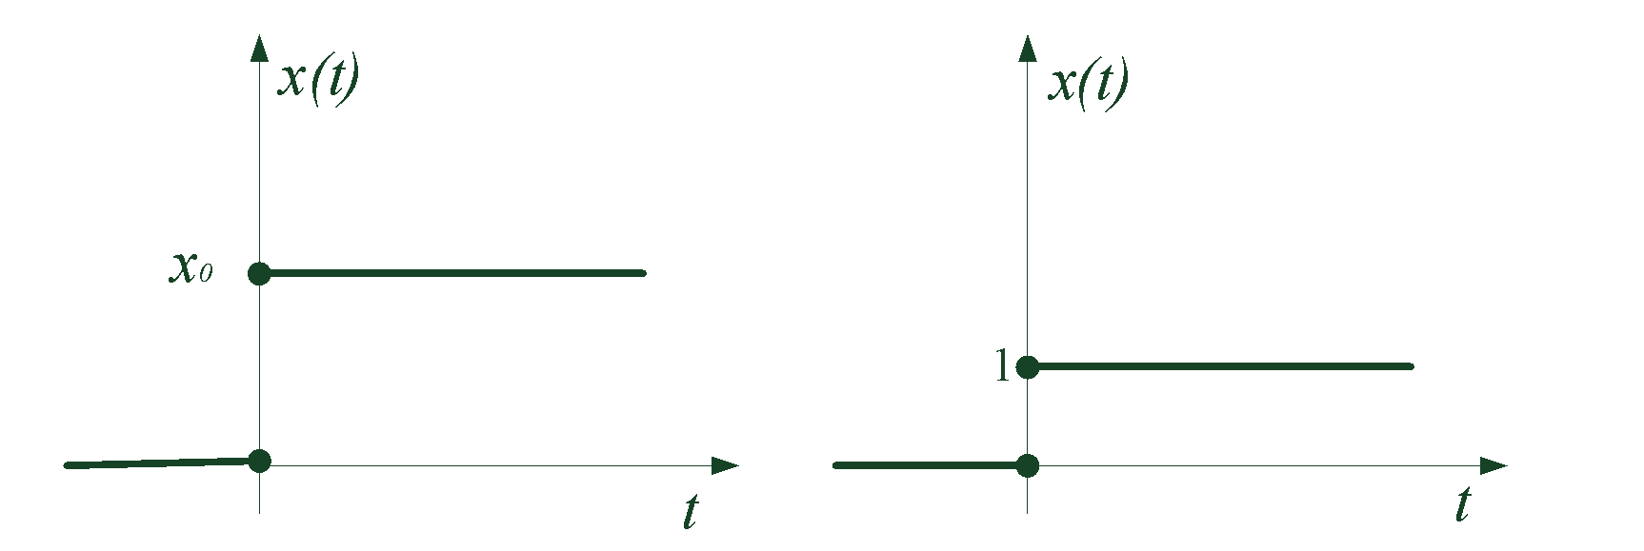
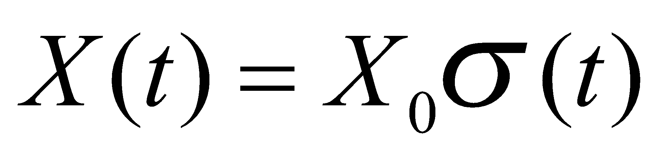
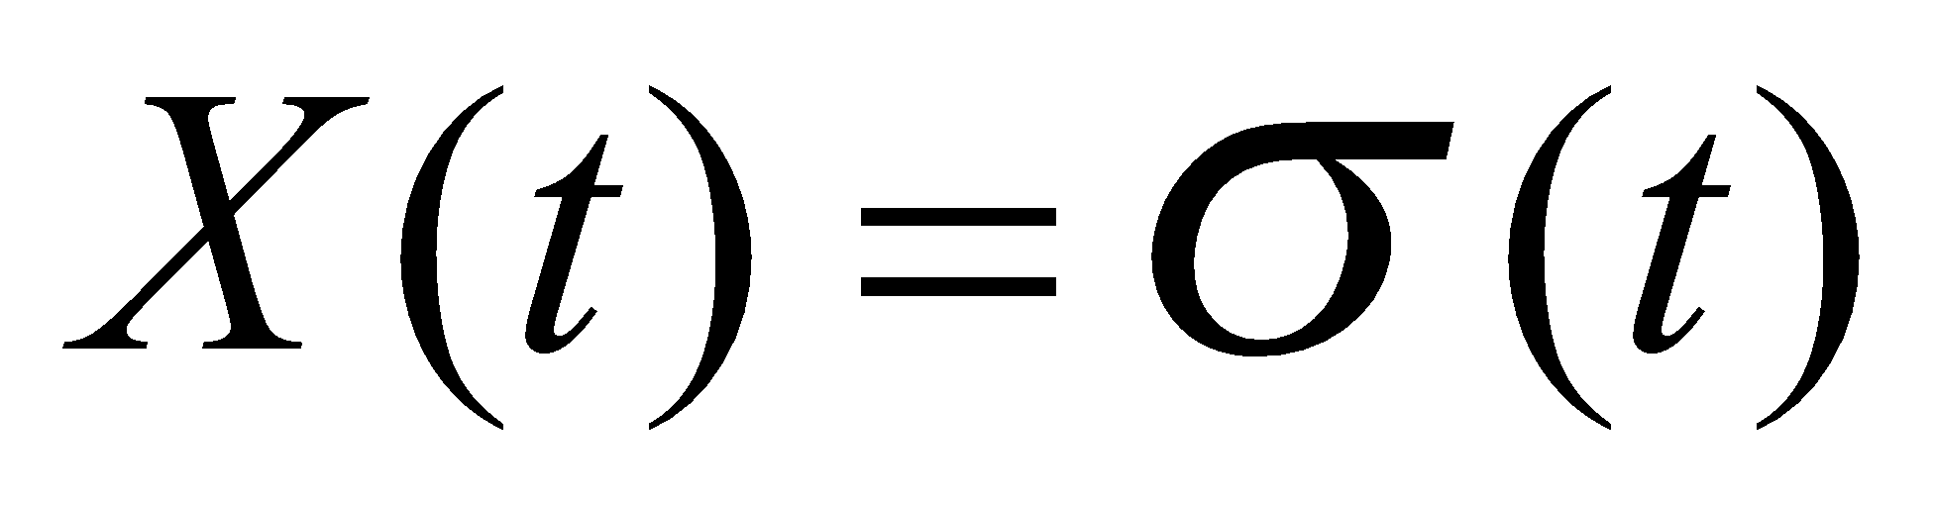
The bounce function

Slide 16
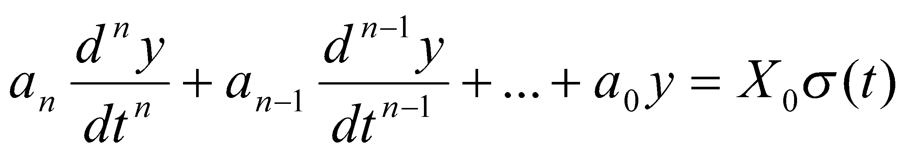
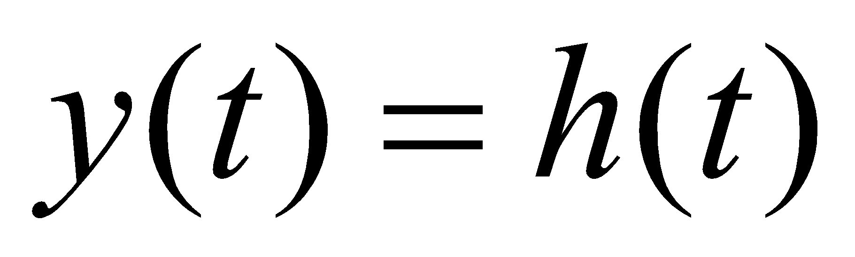
The bounce function
Bounce response is the response of the system to a bounce function. The jump response is the solution of the linear differential equation:
for zero initial conditions. The jump response of a system to a unit jump function is called the transient or time characteristic of the system:

Slide 17
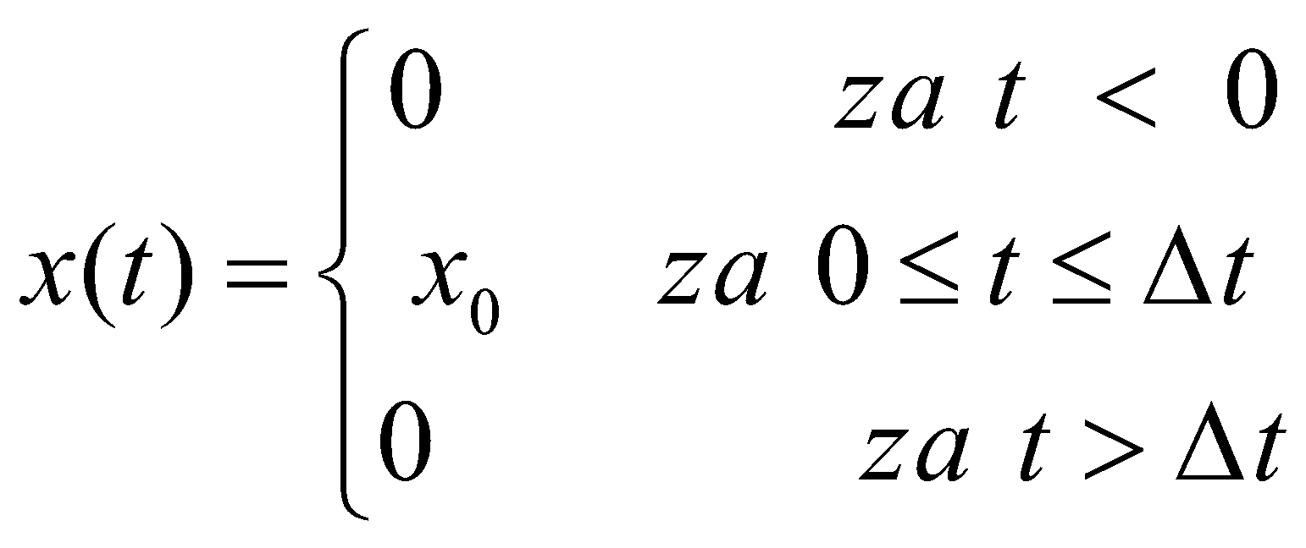
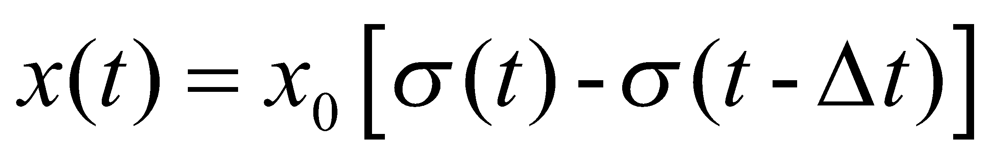
Impulse function
Impulse functionThe impulse function is defined by the relation:
or by the relation:.......

Slide 18
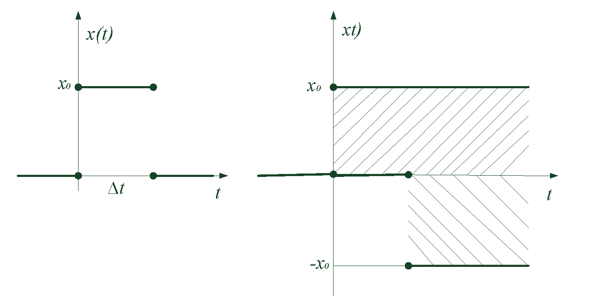
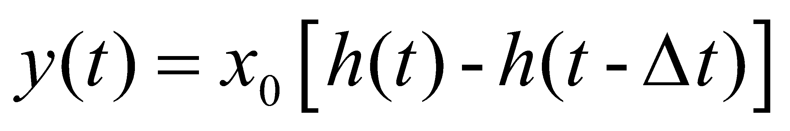
Impulse function
An impulse function can be generated with two jump signals of equal amplitudes but opposite directions, which are mutually offset by time Δt
The response to an impulse function can be represented as the sum of two mutually offset step responses:

Slide 19
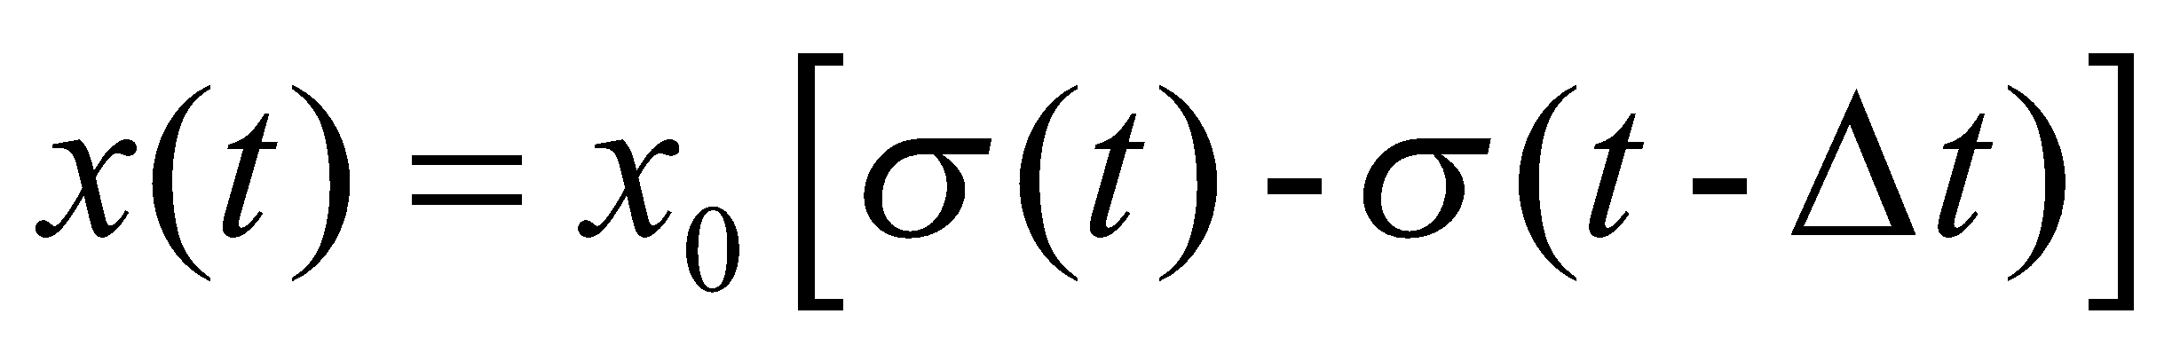
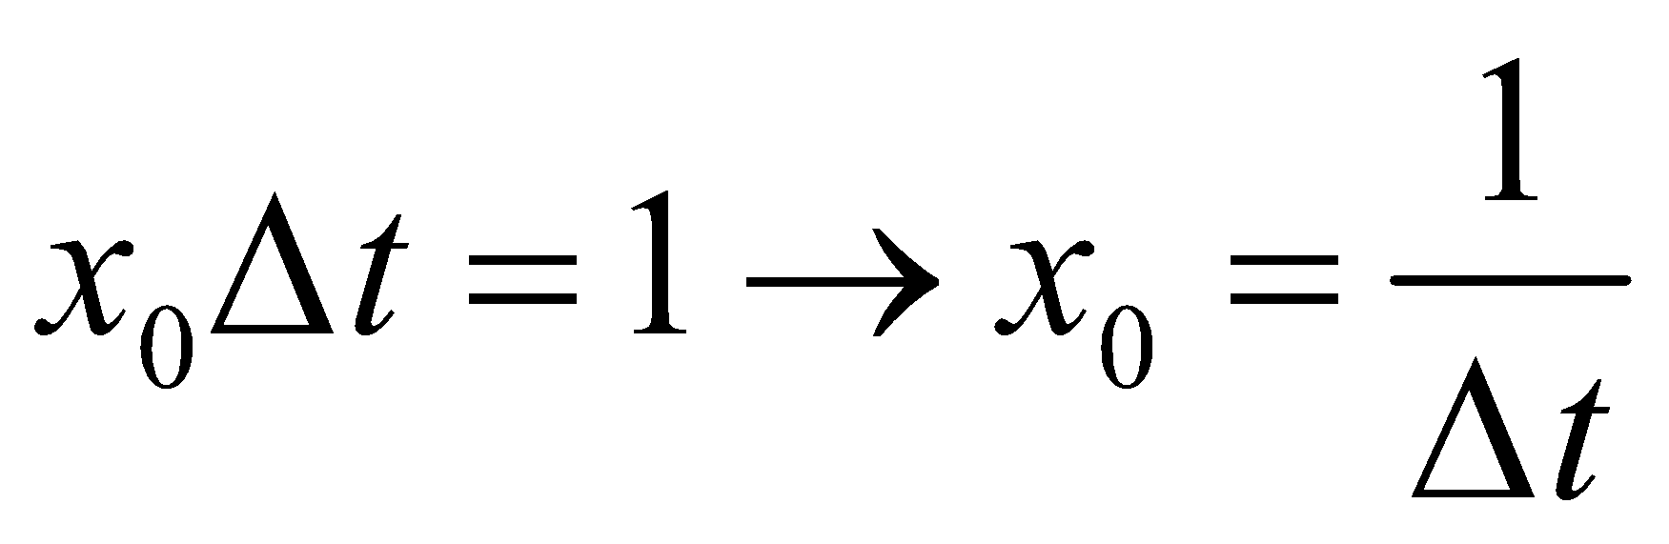
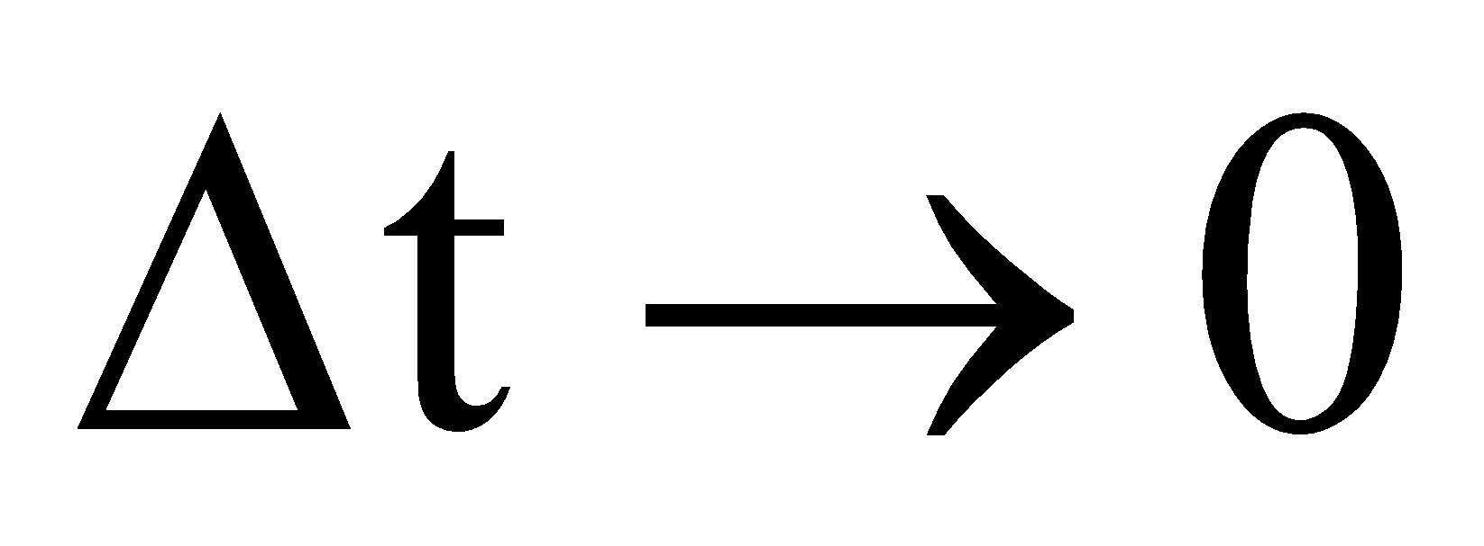
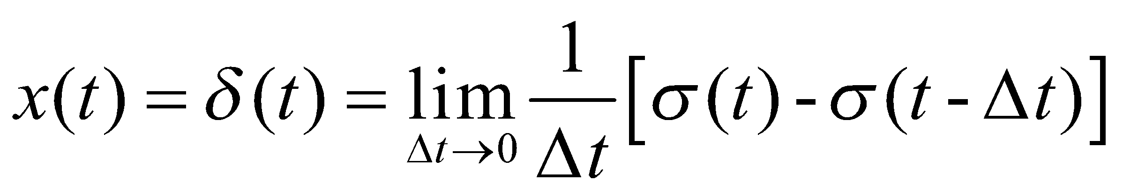
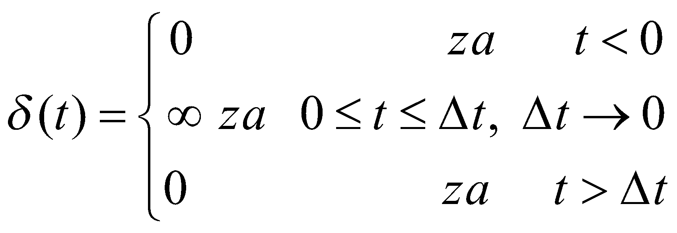
Impulse function
For the case when:
unit impulse or Dirac d-function is obtained

Slide 20
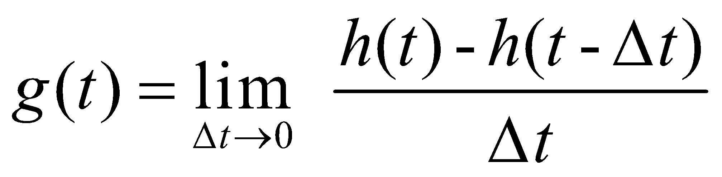
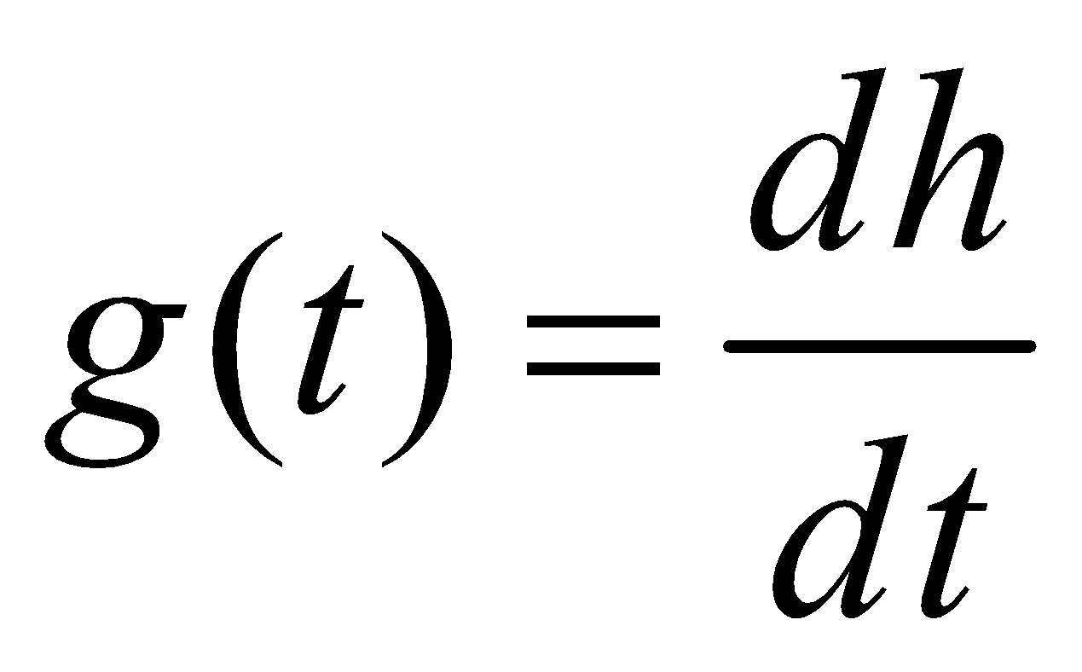
Impulse function
The response of the system to a unit impulse function is called the weight characteristic of the system
If the function h(t) is differentiable, it will be:
The system response to a unit impulse function is equal to the derivative of the system response to a unit step function.

Slide 21
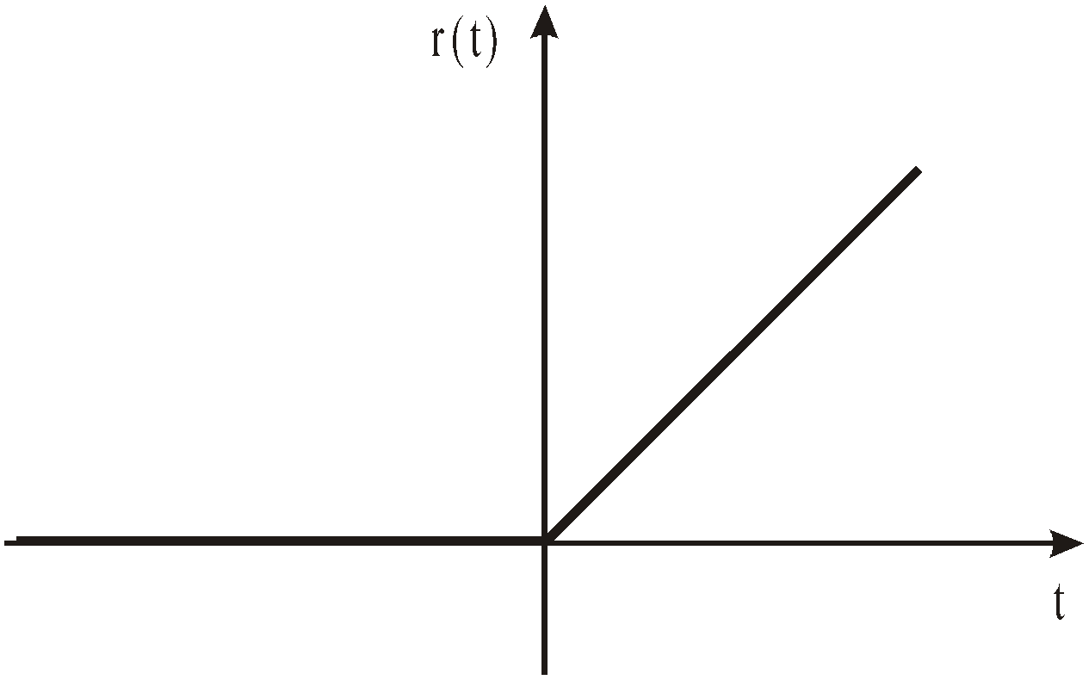
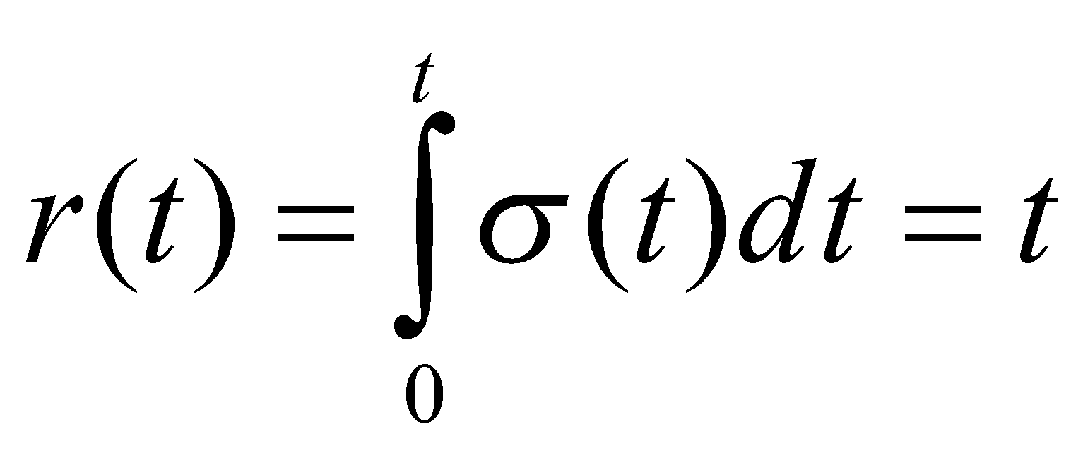
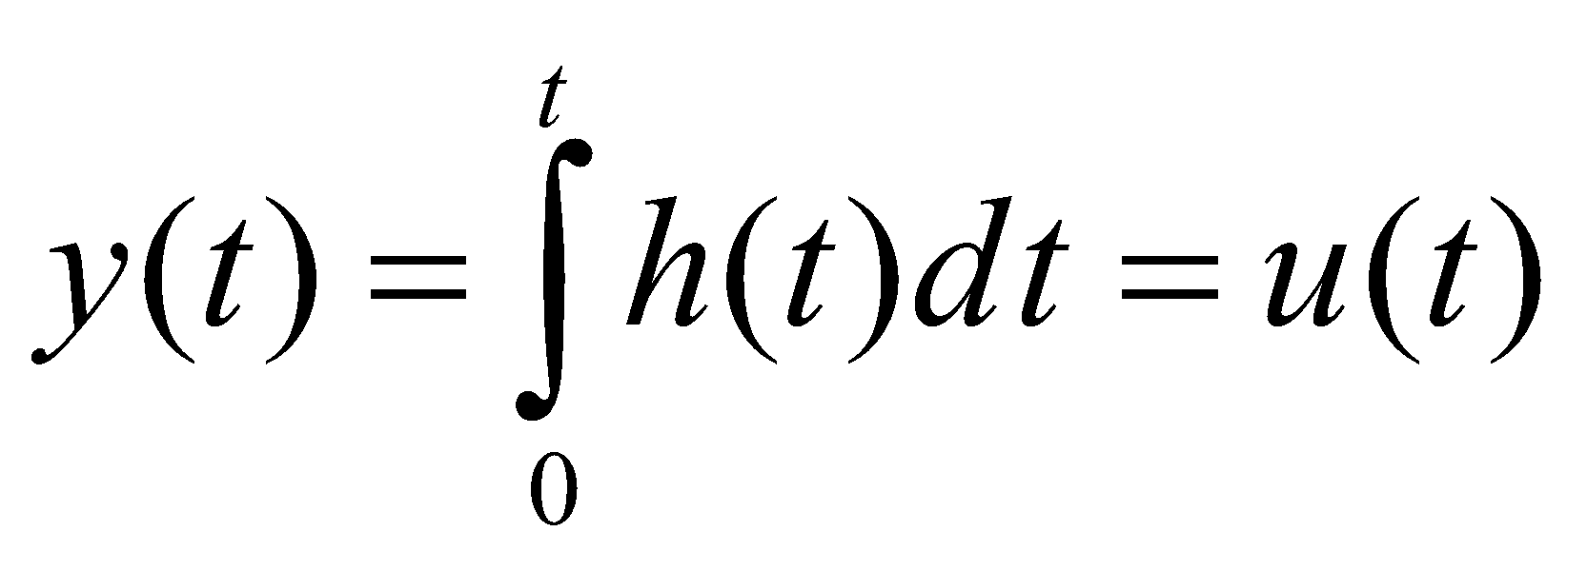
Slope function
The slope function is defined as the unit step integral functions:
The response of the system to the input slope function is equal to the integral of the response of the system to the step function:

Slide 22
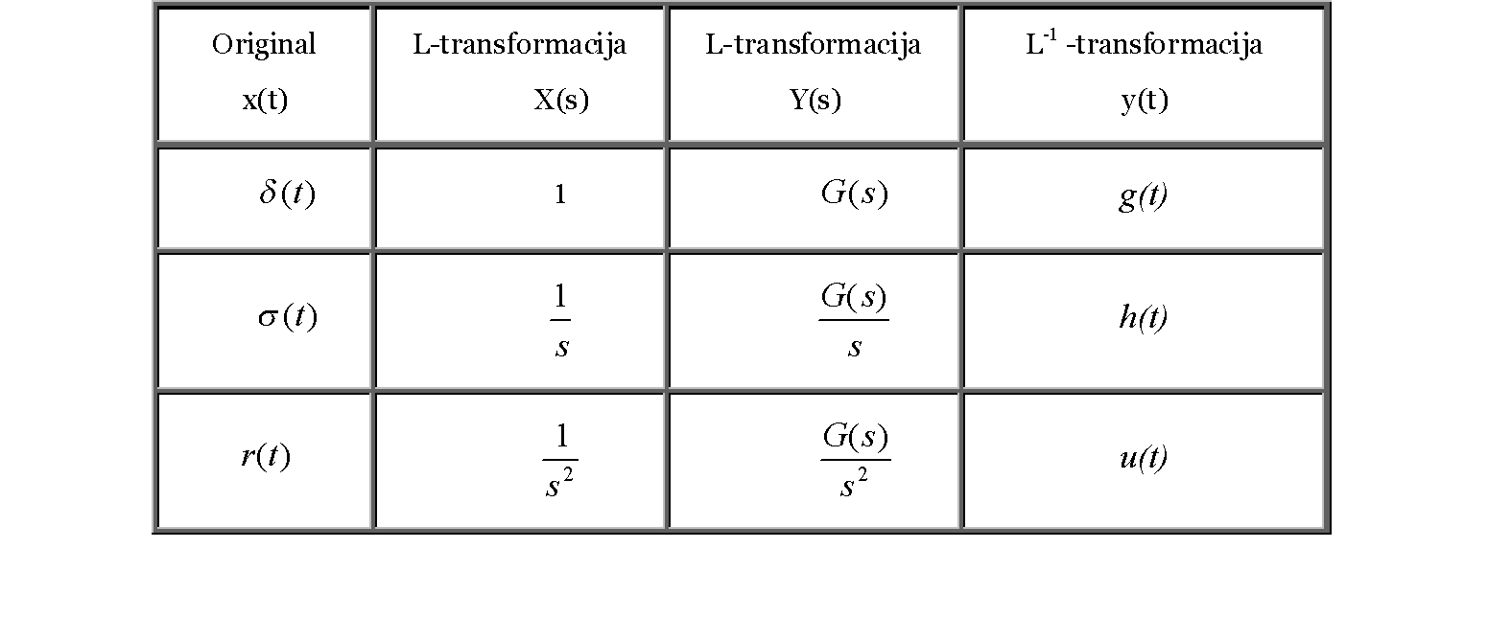
L and L⁻¹ transformations
L and L⁻¹ transformations of test functions and responses

Slide 23
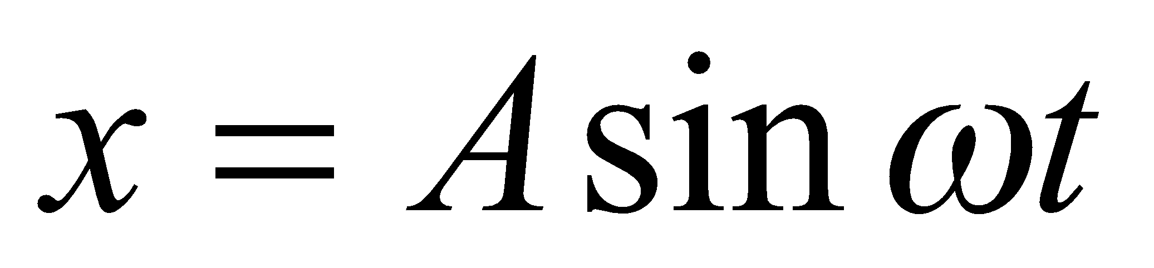
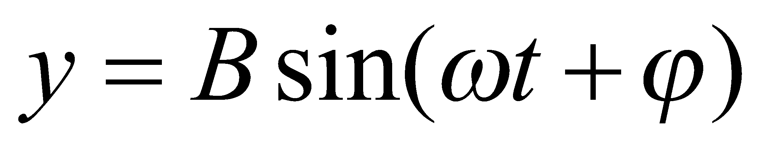
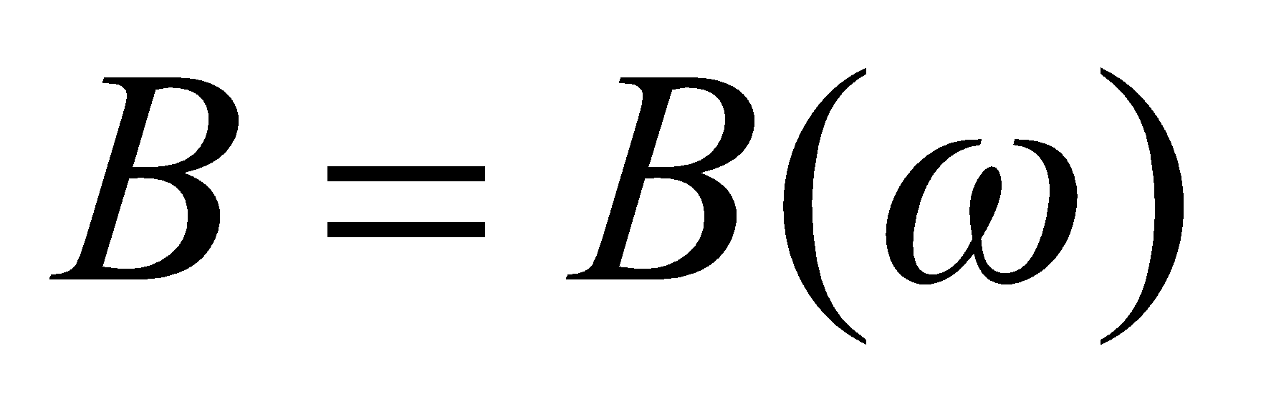
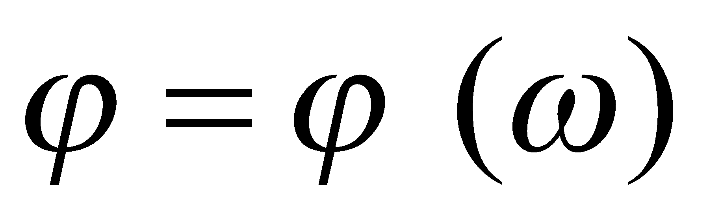
Harmonic function
A harmonic function is a function of the form:
The response of the system to the harmonic function is also harmonicshape function:
If the input signal changes frequency, the amplitude B and the phase shift φ of the output signal change according to the change in frequency ω:

Slide 24
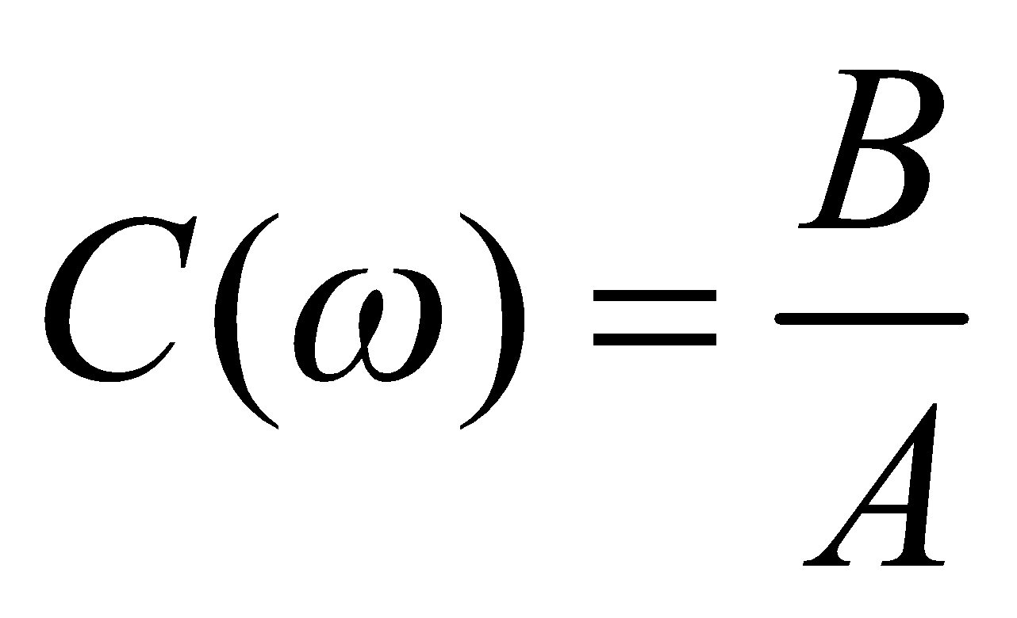
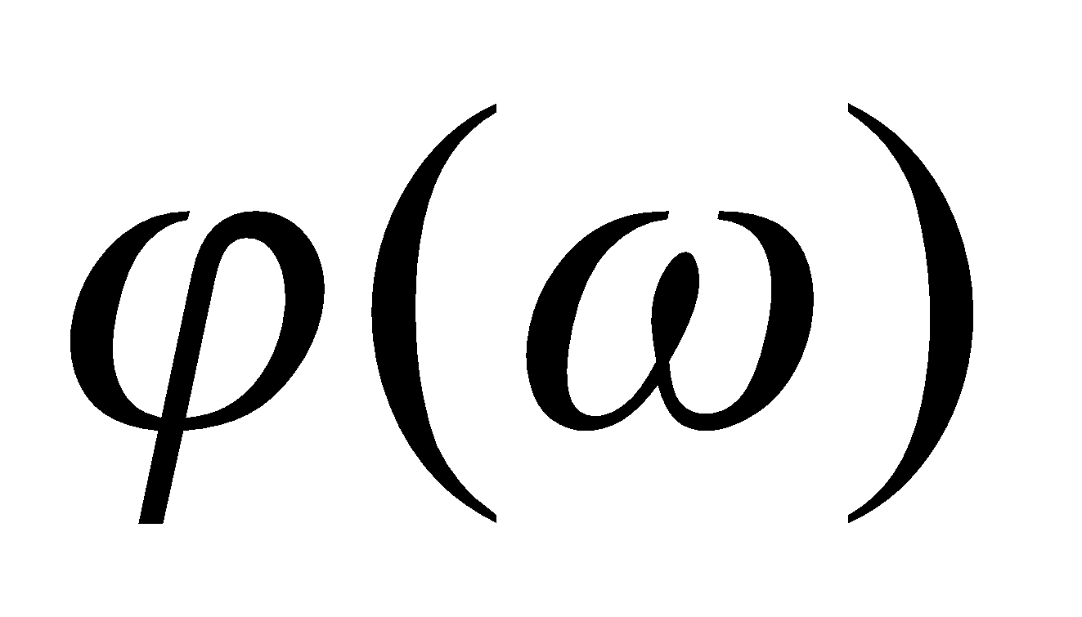

Harmonic function
Dependence of the ratio of the output and input signal amplitudes onfrequency ω is called the amplitude characteristic:
Dependence of the phase shift on the frequency ω nameis the phase characteristic.
The curve connecting the points whose coordinates are for different circular frequencies ω defines the characteristicfrequency or frequency characteristic.

Slide 25
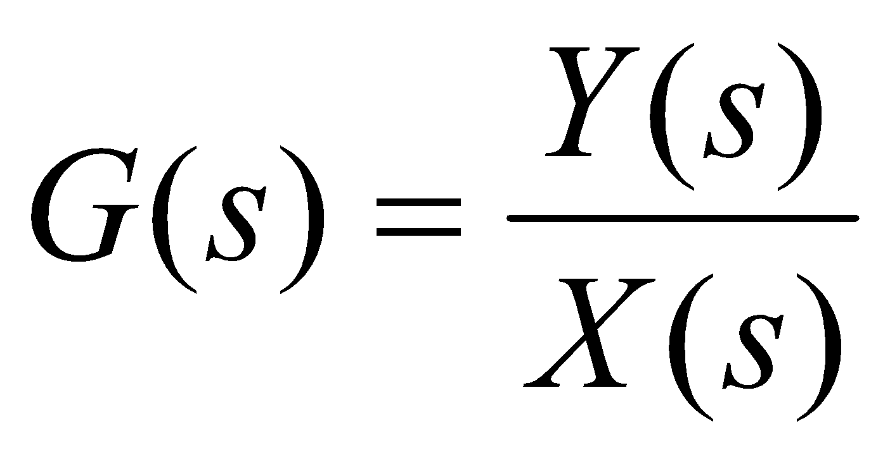
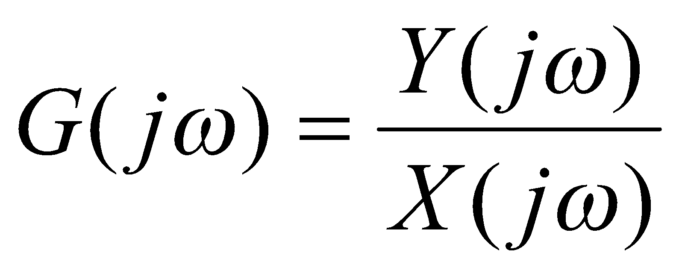

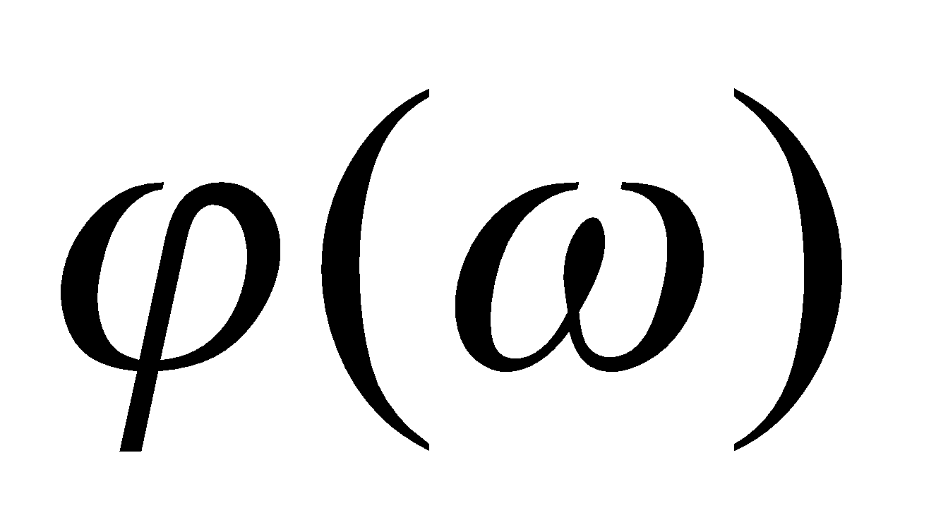
Harmonic function
Mathematically, it is the simplest to determine the characteristicfrequencies using complex functions
The curve connecting the points whose coordinates are ( , )for different circular frequencies w defines the amplitude-phasecharacteristic.

Slide 26
System response to test functions
System response to test functions: system stability
  Jump function: A system is stable if the magnitude of the system's response is bounded at any time instant in which the magnitude of the disturbance is bounded, meaning finite and less than some predetermined value.
  Impulse function: A system is stable if the impulse response of the system tends to zero when the observation time tends to infinity. In this case, the response of the system corresponds to the transfer function G(s), so the study of stability is reduced to the study of the transfer function.

Slide 27
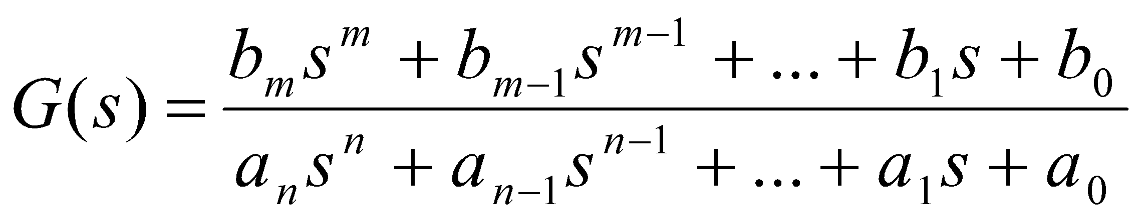
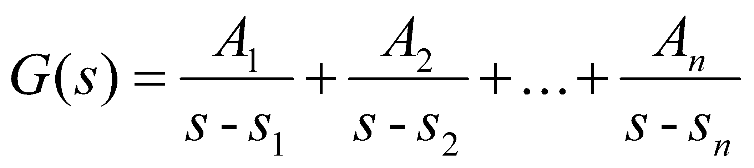
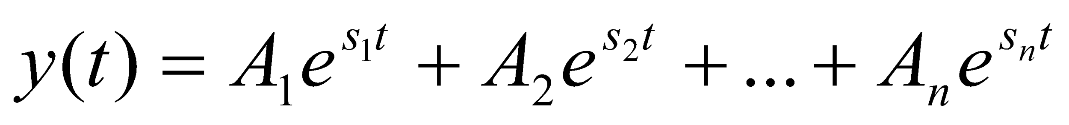
System response to test functions
If S₁,S₂,…,S_{n} are the poles of the transfer function, the transfer function can be written in the form of a sum of partial fractions:
By applying the inverse Laplace transform, the response of the system to the d-function is obtained:
Depending on the sign of the real parts of the complex variable s, the stability of the system can be concluded.

Slide 28
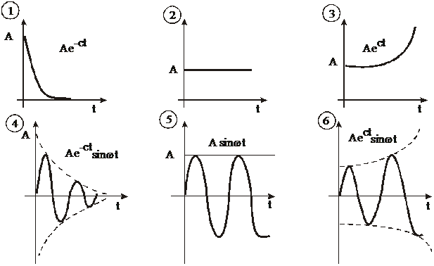
System response to test functions

Slide 29
System response to test functions
The system is stable if the real parts of the poles of the transfer function of the system are less than zero.
It is a necessary and sufficient condition for stability.

Slide 30
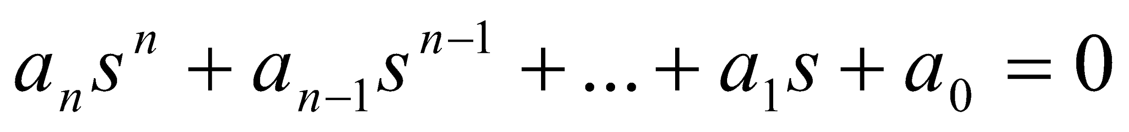
System response to test functions
The stability of the system can be concluded on the basis of the coefficients of the characteristic equation, without solving it beforehand:
A necessary but not sufficient condition for system stability is that all coefficients of the characteristic equation have the same sign and are different from zero.
The system is always unstable if the coefficients of the characteristic equation are not of the same sign, or some of them are equal to zero.
Linear systems of first and second order are certainly stable if they are all coefficients of the characteristic equation are positive and different from zero.

Slide 31

System response to test functions

Slide 32
Literature :
https://www.znrfak.ni.ac.rs

