Slide 1


Field | Automation and robotics
Chapter | The concept and importance of automation
Subtitle | What is automation Fields of automation

Slide 2
The concept and importance of automation

Slide 3
What is automation?

Slide 4
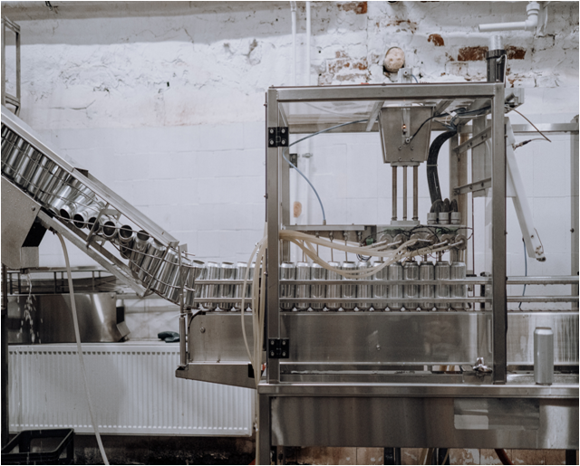
Automation
Introduction
Productivity in industrial production has a great influence on the economic progress and stability of a country. It depends on the level of production automation.
The main task of engineers and technicians is the constant development and implementation into industrial application of highly automated means of work, as well as automation of production.

Slide 5
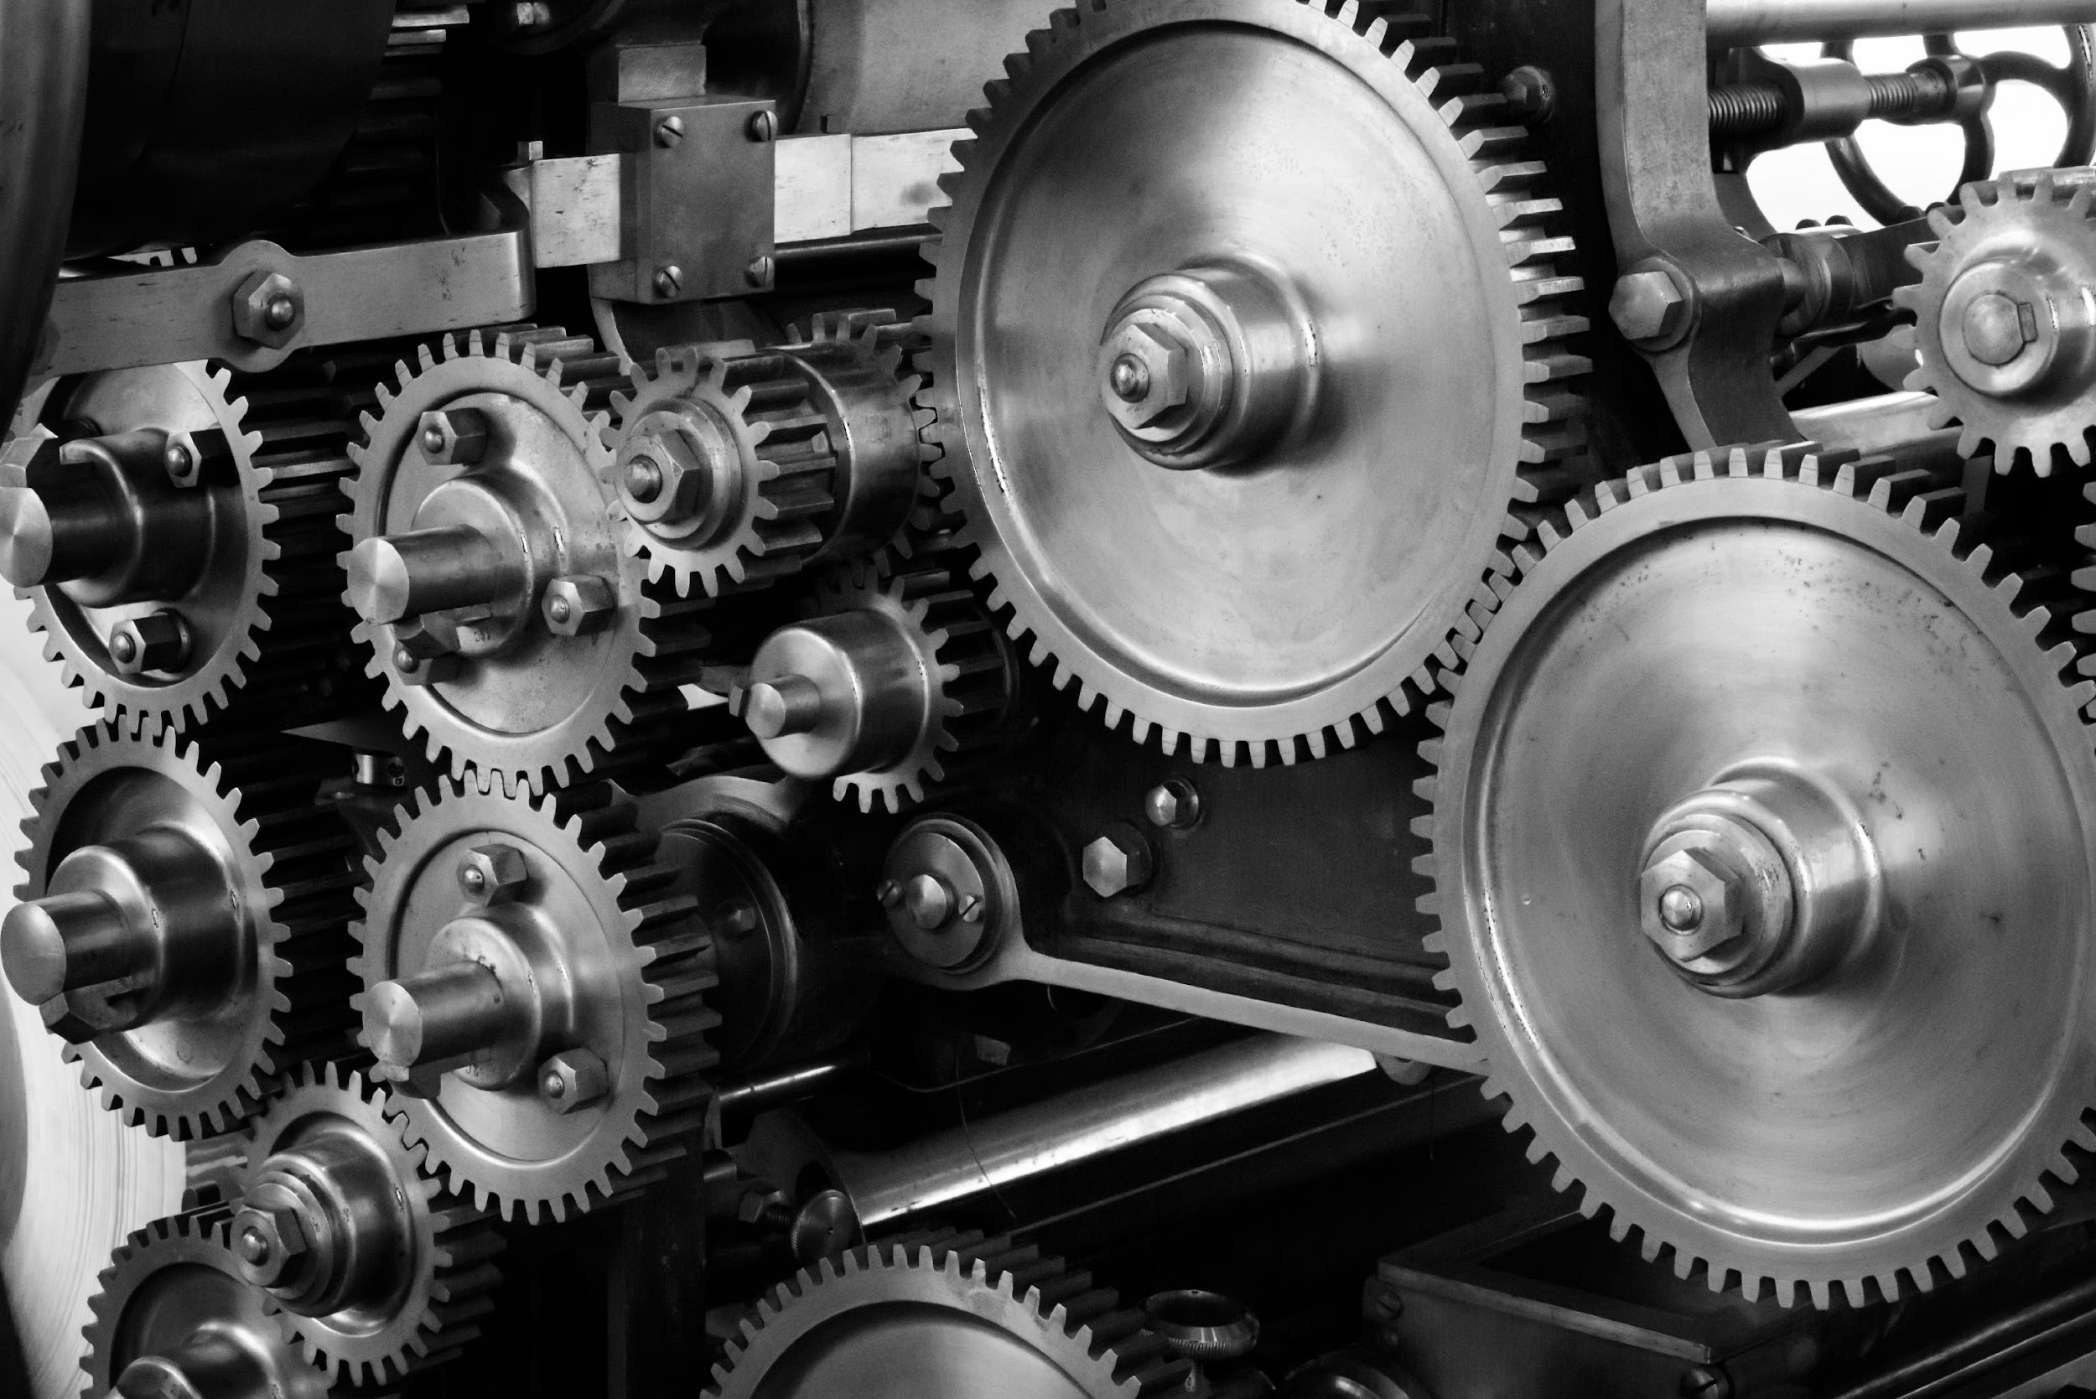
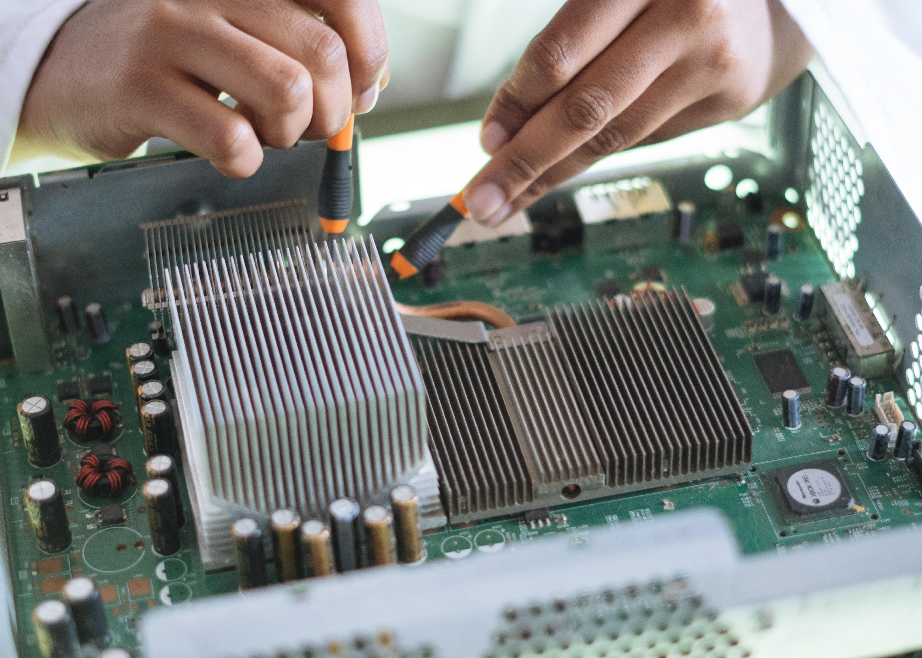

Definition of automation
Automation refers to technology that is based on the use of:
mechanical,
electronic and
computer systems in the management of processes and production processes.

Slide 6
Definition of automation
The use of automation technology began when the work done by a worker was replaced by a machine. The process of technology development is continuously improving until people began to introduce the use of robotics, CAD / CAM, flexible manufacturing systems, and other technologies.

Slide 7
APPLICATION OF AUTOMATION

Slide 8

Application of automation
To increase labor productivity. Automation of production operations usually increases the rate of production and labor productivity. This means a higher performance per hour of work invested.

Slide 9

Application of automation
- Reduction of labor costs. Increasing labor costs have been and continue to be a trend in industrial societies around the world. Consequently, larger investments in automation have become economically viable to replace manual operations.

Slide 10
Application of automation
To replace the lack of manpower. In many advanced countries, there is a general shortage of manpower and this has encouraged the development of automated operations as a substitute for manpower.

Slide 11
Application of automation
To reduce or eliminate routine manual tasks. It can be argued that there is social value in automating operations that are routine, tedious, and exhausting. Automation of such tasks serves to improve the general level of working conditions.

Slide 12

Application of automation
To improve worker safety. Automation operations provided shifting workers from active participation in the process to a supervisory role, and this made the work feels safer. The safety and health of workers have become a national goal with the adoption of the Law on Safety and Health at Work. This gave impetus to automation.

Slide 13
THE ROLE OF AUTOMATION IN INDUSTRY

Slide 14
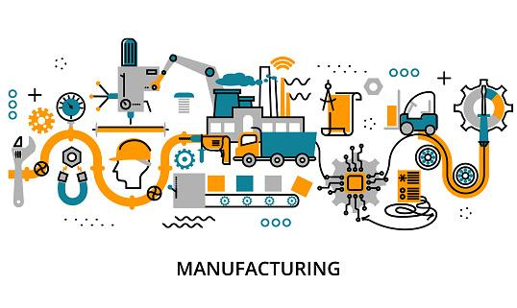
The role of automation in industry
Production processes produce the finished product from raw/unfinished material using energy, labor, equipment, and infrastructure.

Slide 15
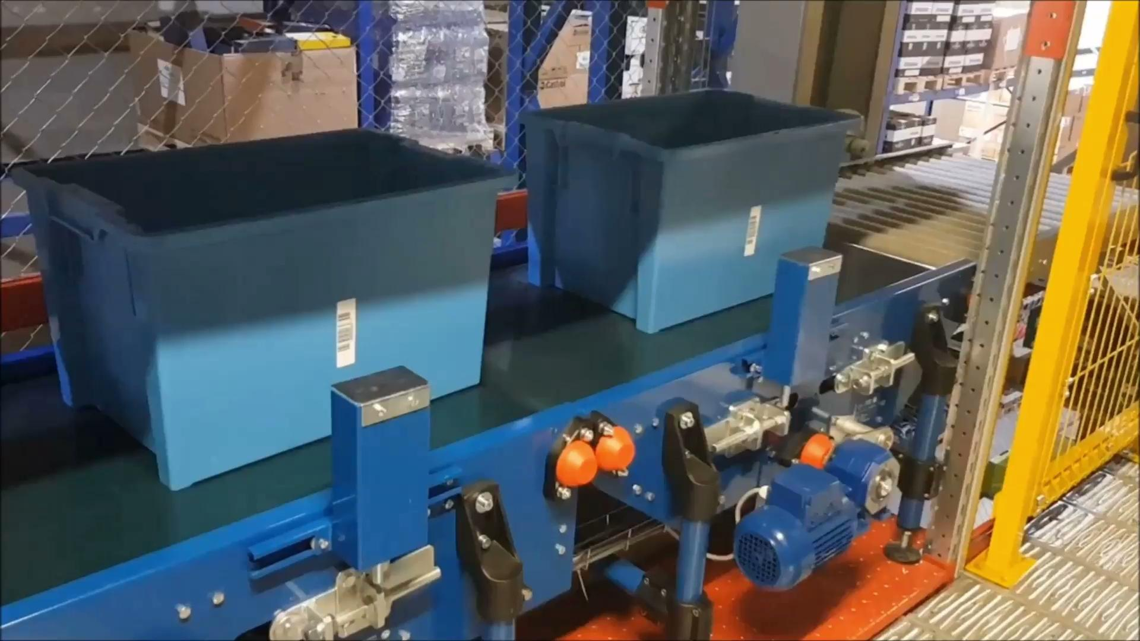
The role of automation in industry
Since the industry is essentially a "systematic economic activity", the basic goal of any industry is to make a profit.

Slide 16
The role of automation in industry
Roughly speaking, profit = (price / unit - cost / unit) * production volume. So the profit can be increased by producing good quality products, which can be sold at a higher price, in larger quantities with fewer production costs and time. Figure 1 shows the main parameters that affect the price/unit of mass production products.
Price/Unit
Material
Energy
Labor
Infrastructures

Slide 17
THE DIFFERENCE BETWEEN AUTOMATION AND MECHANIZATION

Slide 18
The difference between automation and mechanization
Mechanization refers to the replacement of human strength with mechanical strength. The use of hand-held power tools is not an example of mechanization.
Automation and mechanization are often mixed with each other. Mechanization saves the use of human muscles, while automation saves the use of human judgment. Mechanization replaces physical work, while automation replaces mental work.
Mechanization affects one or two industries at the same time. Automation is the replacement of human thinking with computers and machines. Automation opens the workplace for skilled workers and affects many industries at the same time.

Slide 19
WHAT ARE THE ADVANTAGES AND DISADVANTAGES OF AUTOMATION?

Slide 20
What are the advantages and disadvantages of automation?
Advantages | Disadvantages
- To increase labor productivity. - To reduce labor costs. - To convey the consequences of labor shortages. - To reduce or eliminate routine, manual tasks. - To improve security. - To improve the product. - To reduce production time. - To accomplish processes that cannot be done manually. | - Higher start-up costs and labor costs. - Higher maintenance costs. - It is not economically justified for small-scale production

Slide 21
THANKS!
Any questions?

